Slide 1
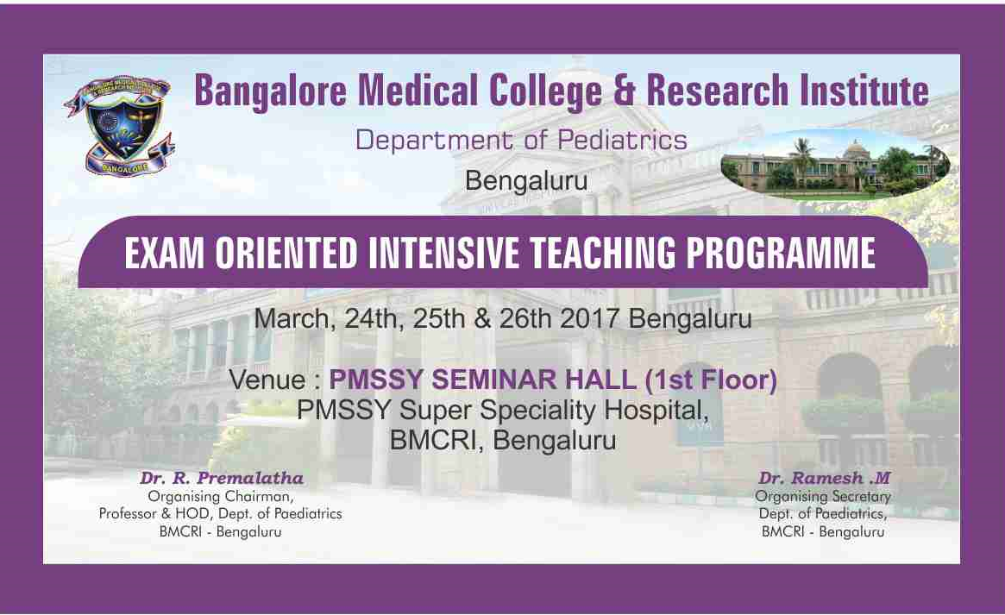

Slide 2
TODAYS PROGRAMME
8.30 TO 10.30- NEWBORN-DR. SWARNA REKHA BHAT, DR.SUMAN RAO
10.30 TO 10.45- TEA BREAK
10.45 TO 1.00-CVS,ECG-DR KIRAN DR NATESH
1.00 TO 1.30-LUNCH
1.30 TO 3.30-RS –DR SUBRAMANYADR NAGABHUSHAN
3.30 TO 3.40-TEA BREAK
3.40 TO 4.30-XRAYS DISCUSSION-DR NAGABHUSHAN

Slide 3
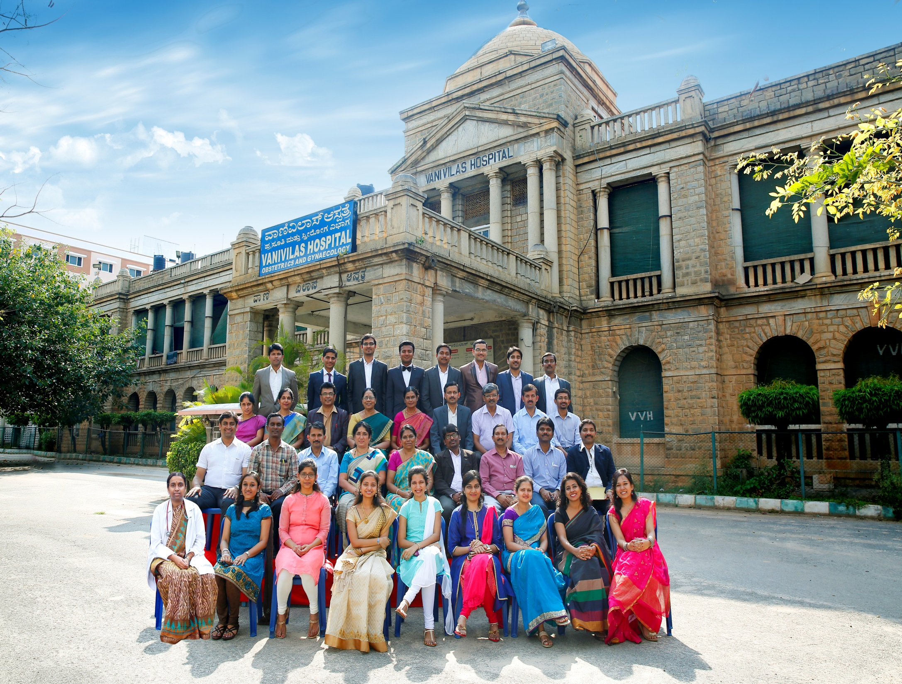

Slide 4


Slide 5


Slide 6
NEWER TB GUIDELINES
DR. INDHUMATHI
DR. SWATHI KIRAN SHIRI

Slide 7
DR.INDHUMATHI
PROFESSOR,DEPT OF PEDIATRIICS, ST. JOHNS HOSPITAL
BMCRI ALUMINI
AREAS OF INTEREST- INFECTIOUS DISEASES, ESPECIALLY PEDIATRIC TUBERCULOSIS WITH MANY PUBLICATIONS ON TUBERCULOSIS

Slide 8


Slide 9
NEWER HIV GUIDELINES
DR. CHITRA DINAKAR
DR.ANGEL CHAM PHILIP

Slide 10
DR. CHITRA DINAKAR
PROFESSOR, DEPT OF PEDIATRICS, ST.JOHNS MEDICAL COLLEGE AND HOSPITAL

Slide 11


Slide 12


Slide 13
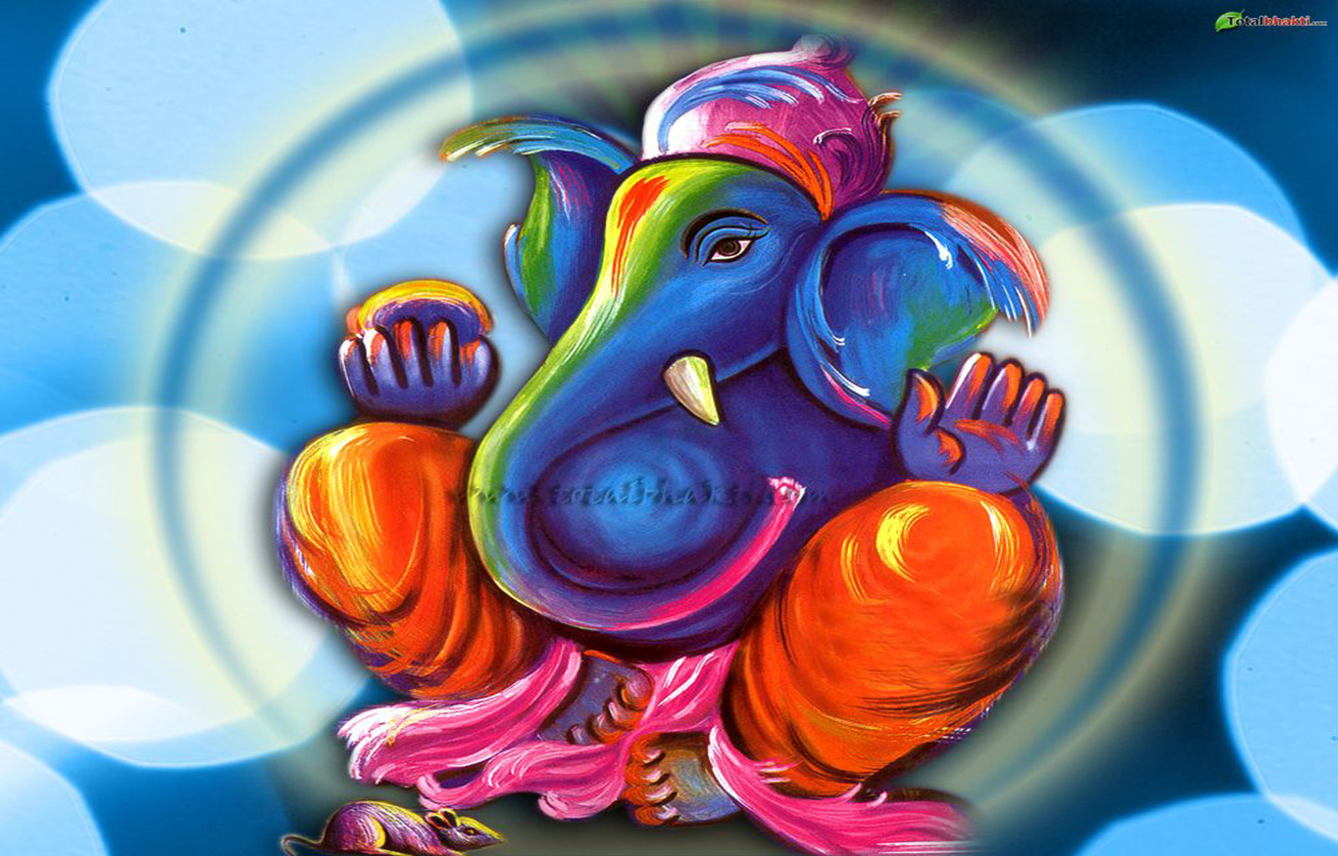
INVOCATION
-DR DR.KALPANA

Slide 14

DR RAMESH

Slide 15
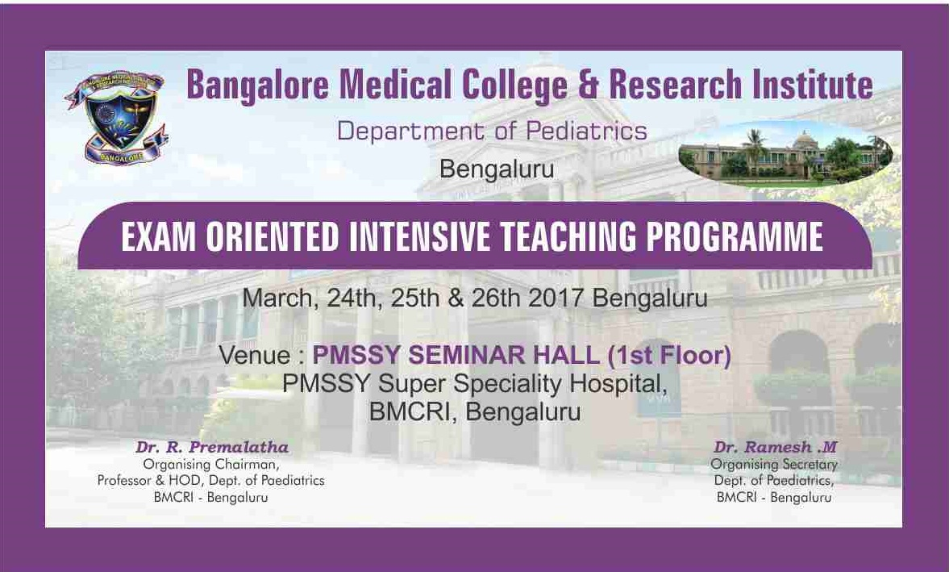
OVERVIEW

Slide 16
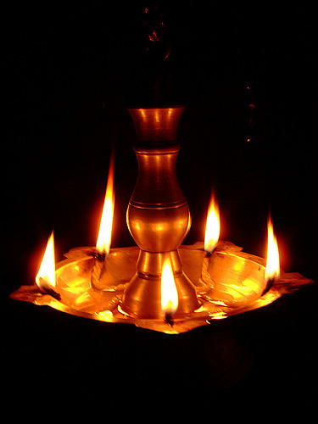
LAMP LIGHTING CEREMONY

Slide 17
ADDRESS BY DEAN
DR.SACHIDANAND

Slide 18


Slide 19


Slide 20


Slide 21
CENTRAL NERVOUS SYSTEM
CEREBRAL PALSY
DEVELOPMENTAL ASSESSMENT
STROKE IN YOUNG

Slide 22
DR.SHIVANANDA
EMINENT PROFESSOR,REPUTED TEACHER
UG AND PG BMCRI
FORMER SUPERINTENDENT VVH
FORMER PROFESSOR AND HOD VVH
FORMER DIRECTOR IGICH
FORMER PRESIDENT IAP BPS,ID CHAPTER

Slide 23
DR.UDAY KUMAR
PROFESSOR ESI -PGMSR , BANGALORE
UG-BELLARY MEDICAL COLLEGE
DCH-MYSORE MEDICAL COLLEGE
MD-BMCRI, BANGALORE
WORKED AS LECTURER/ASST PROFESSOR,BMCRI
AREAS OF INTEREST-GENERAL PEDIATRICS
UG/PG EXAMINER,RGUHS,NTR UNIVERSITY, MGR UNIVERSITY

Slide 24
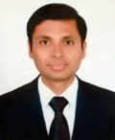
DR.PRAVEEN KUMAR
Present Designation:
Professor and Head of Department of Neurology.
Present Affiliation:
Bangalore Medical College and Research Institute, Bangalore.
Areas of Interest:
Epilepsy, Autoimmune disorders of CNS, Headache, Movement disorders.
Honors/Awards:
The prestigious Indian Academy of Neurology Award for Best Research Paper 2006; Neurology Young Scholar Award 2010
PAPER PRESENTATIONS at various national and international Neurology conferences.
Publications: National journals and international journals
Membership to Professional Bodies: API,IAN,IES,IEA,ISO, KNA, BNS
Photograph
Dr. S. Praveen kumar
MBBS (BMCRI, BLORE) D.M. Neurology (NIMHANS)
Bangalore

Slide 25


Slide 26
STOKE IN YOUNG

Slide 27

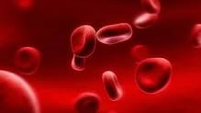

Slide 28
HAEMATOLOGY
THALASSEMIA
ANAEMIA AND BLEEDING
MALIGNANCY

Slide 29
DR.ANAND PRAKASK

Slide 30
DR.MEERA
HAEMATOLOGIST, BMCRI, BANGALORE
UG-AMBEDKAR MEDICAL COLLEGE
PG-BMCRI
DM- HAEMATOLOGY- KEM MUMBAI
HEAD OF COMPREHENSIVE HAEMOPHILIA CARE CENTRE VICTORIA HOSPITAL

Slide 31
DR.SUNIL BHAT
SENIOR CONSULTANT AND HEAD PEDIATRIC HEMATOLOGY, ONCOLOGY AND BLOOD AND MARROW TRANSPLANTATION,
MAZUMDAR SHAW CANCER CENTRE,NARAYANA HEALTH CITY BANGALORE
CHAIRPERSON OF STEM CELL TRANSPLANT WORKING GROUP ,PHO CHAPTER OF IAP

Slide 32


