Slide 1
Fluid and Electrolyte in Neonates
? Why is this Important
Neonatal physiology is different
Fluid management is not uniform
Serious morbidity can result from wrong fluids
Organ systems are ill equipped to handle blunders !
Fluids must be “ Tailor made “

Slide 2
How is it Different ?
T B W E C F I C F
Adult 60% 20% 40 %
Term 75% 40% 35%
Preterm 80-90% 60% 30%

Slide 3
Fluid compartments
T B W = E C F + I C F
E C F = Intravascular + Interstitial

Slide 4
Organs Regulating Fluid balances
Cardio- Vascular system
1. Immature Myocardium –
↓ contractile elements
Unable to respond to volume overload
2. Poor capillary integrity
Intravascular volume depletion

Slide 5
Renal System
Only 25% functional ability at birth
Poor diluting and concentrating ability
↑ Intra vascular volume → edema
Tubular immaturity - polyuria

Slide 6
Renal system – contd
Preterm <30wks - Natriuresis with
hyponatremia
Concentrating ability improves from
30 wks onwards

Slide 7
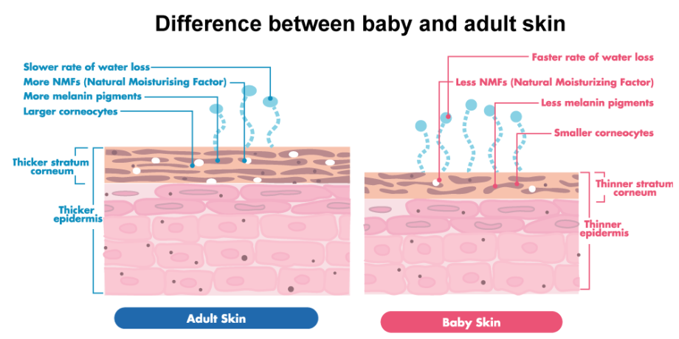
Skin in a preterm baby

Slide 8
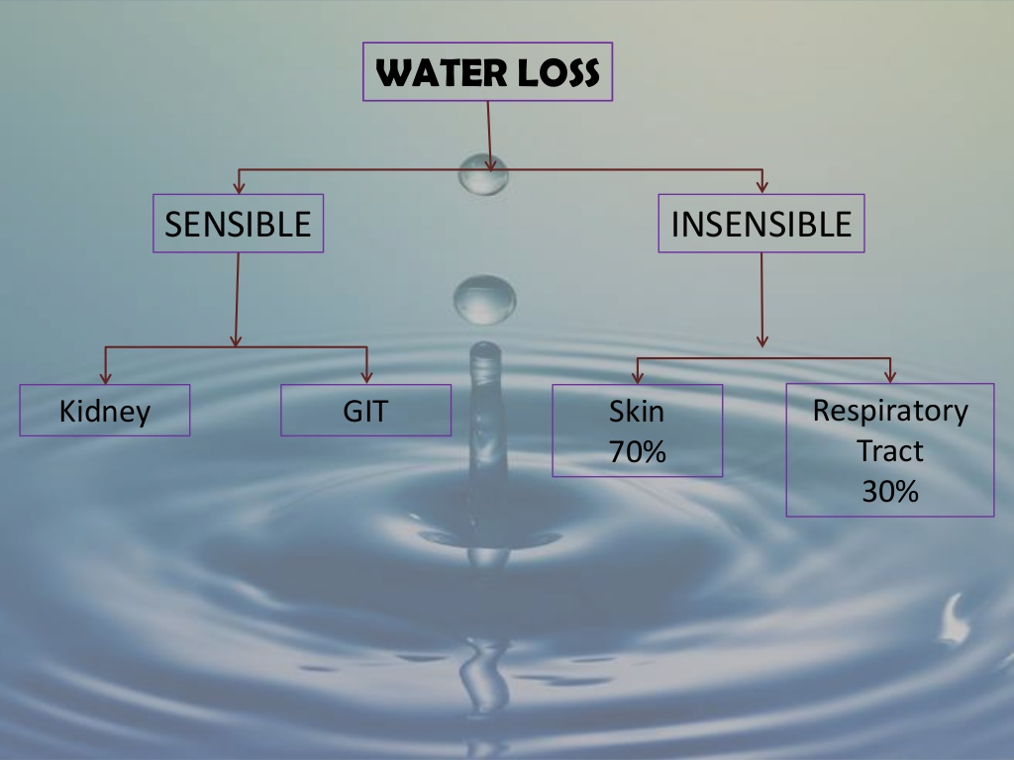

Slide 9
Insensible Water Loss
70% I W L = Skin
30% I W L = Resp Tract

Slide 10
Insensible Water Loss
< 1000 gms - 100ml/kg/day
1000-1500gms – 60ml/kg/day
>1500 gms -- 20ml/kg/day

Slide 11
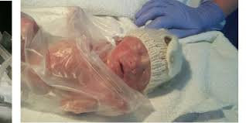
Premie with Cling wrap

Slide 12
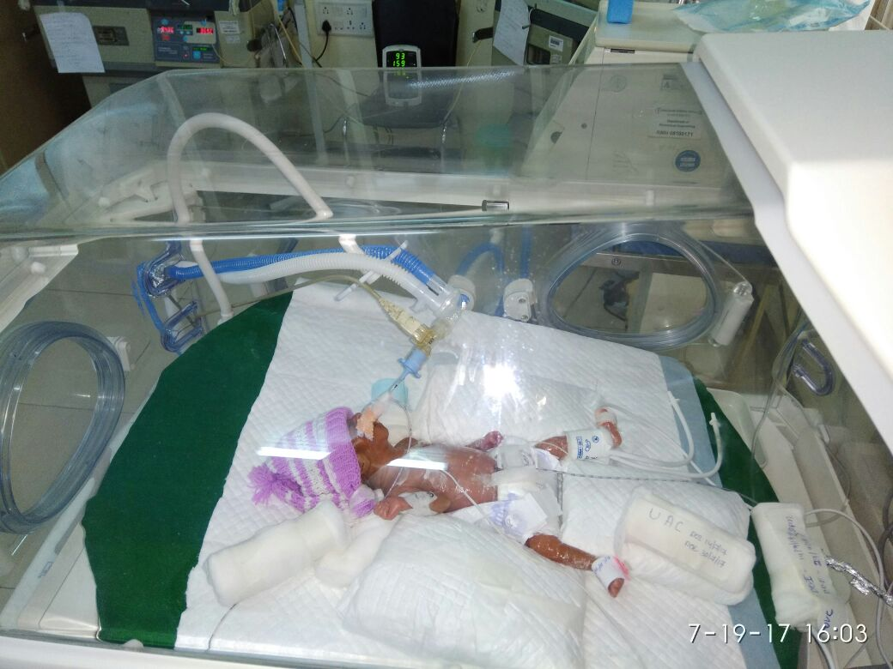

Slide 13
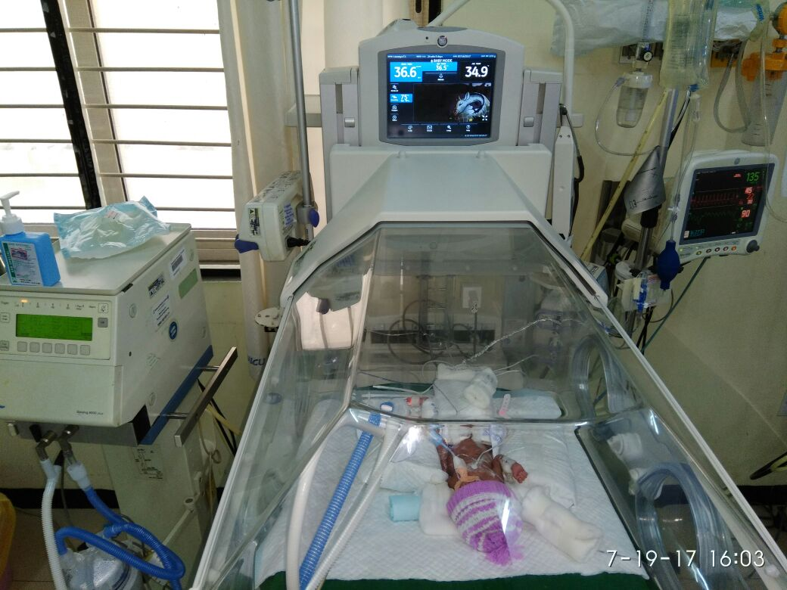

Slide 14
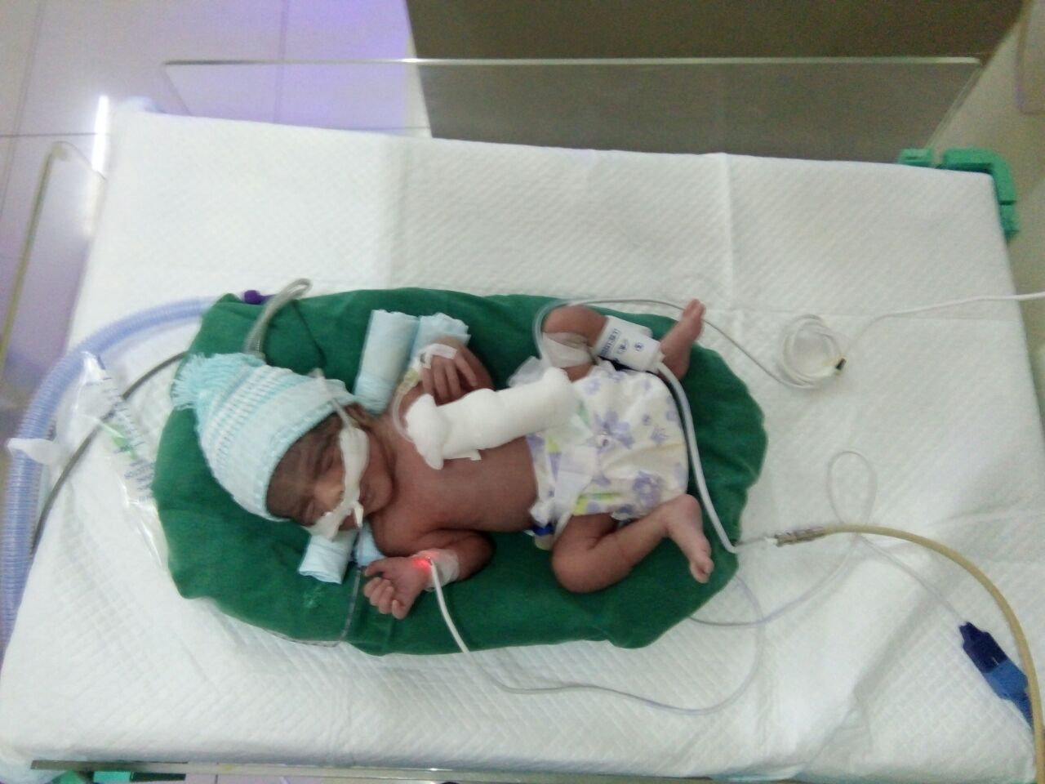

Slide 15
Sensible Water Loss
Urine output
preterm – 2-3ml/kg/hr
Osmolality -60-600mOsm/L
Stool output
preterm - 7ml/kg/day
Term - 10ml/kg/day

Slide 16
Factors affecting I W L
↑ I W L ↓ I W L
Warmer Incubator
Phototherapy Heat shield
↑ R R Cling Wrap
Skin injury-tapes Caps
Low Humidity socks

Slide 17
Cling Wrap
↓ I W L by 50-70%
PREVENTION -
of I W L should be the goal

Slide 18
Fluid Calculation
Term Baby - 60-70ml / kg
↓ How ? ?
Solute load - 15mOsm/kg/day in urine
Urine output – 50ml/kg/day
+ I W L - 20 ml / kg/ day
Total fluid - 60-70ml/kg/day
1st 24 hrs - 10% Dextrose - No lytes

Slide 19
Fluid calculation – Preterm
Urine output – 50-60ml /day
+ I W L > 30-40ml / kg /day
Total = 80-100ml/kg/day

Slide 20
Monitoring Fluid status
Body weight -
Term baby - loss of 1-3% daily
Cumalative loss – 5-10% in 1st week
Preterm babies – 2-3% daily
Cumalative loss - 15% by 1 week
NOTE – Body Weight reflects TBW,
not intra vascular fluid
Puffy baby may be fluid depleted ! !

Slide 21
Monitoring Fluid Status -
2. Clinical signs of Dehydration
- sunken AF, poor turgor etc
MOST UNRELIABLE
3. Serum Sodium – 135- 145 mEq /L
Serum Osmolality

Slide 22
Monitoring Fluid status
4. Urine Output -1-3ml /kg /day
Urine specific gravity - 1005-1010
Urine Osmolality - 100-400 mOsm / L
5. A B G - Metabolic acidosis
6. Serum Creatinine –
must ↓ in first week
Failure to decline ? Is worrying

Slide 23
Guidelines - Fluids
↑ ↑ Fluids ↓↓ Fluids
Wt loss > 3% No wt loss
Na > 145 Na < 130
Urine sp grav>1020 Sp grav <1005
Output <1ml/kg/hr U O >3ml kg/hr

Slide 24
Daily increment in fluids
1. With feeds – Solute load ↑ in urine
2. ↑ water for growth and fecal losses
↓ ---so
Total fluids ↑ by 15-20 ml/kg/day
Add Lytes after 48 hrs - Na, K
G I R - 4-6 mg / kg /min

Slide 25
Fluids at end of a week
Skin of a preterm baby - Matures
- I W L ↓ in preterm babies
Total fluids – 150-160ml/kg/day
Na reqr 2-3mEq /kg/day in term
4-5mEq/kg/day in preterm
( till 33-34 wks )
K reqr - 2 mEq/kg/day in all babies

Slide 26
Lytes -- contd
Calcium - 1st day - < 1500 gms
35-70mg/kg/day elemental calcium
4-8 ml /kg /day - 10 % Ca gluconate

Slide 27
Sodium Problems
Hyponatr + wt loss -- ↑ sodium
Hyponatr + wt gain -- ↓ fluid
Hypernatr + wt loss -- ↑ fluid
Hypernatr + wt gain -- ↓ fluid
↓ Sodium

Slide 28
Hyponatremia –Treatment
( Desired – Actual ) × 0.8 × body wt
? ? How rapid – SYMPTOMATIC CASES
correct till 125mmoL – 1st 6 hrs
rest over 24hrs
ASYMPTOMATIC - ½ CORRECTION – 12HRS
¼ - BY 18 HRS
¼ - BY 24 HRS

Slide 29
HYPERNATREMIA
? ? CAUSES 1. Negative water balance
2. Sod bicarb, conc formula
Symptoms - Hyperreflexia, seizures, coma
? Permanent CNS sequelae
CORRECTION - SLOW PROCESS
↓ about 10 mEq every 12 hrs

Slide 30
HYPERKALEMIA
k + = > 6 mEq/L
brady, arrhythmia, ventr. Fibrillation
Early EKG –peaked t wave, wide QRS
? ? Causes
Non-oliguric hyperkalemia(ELBW )
Sepsis, ARF, acidosis, CAH
Haemolysed sample –beware ! !

Slide 31
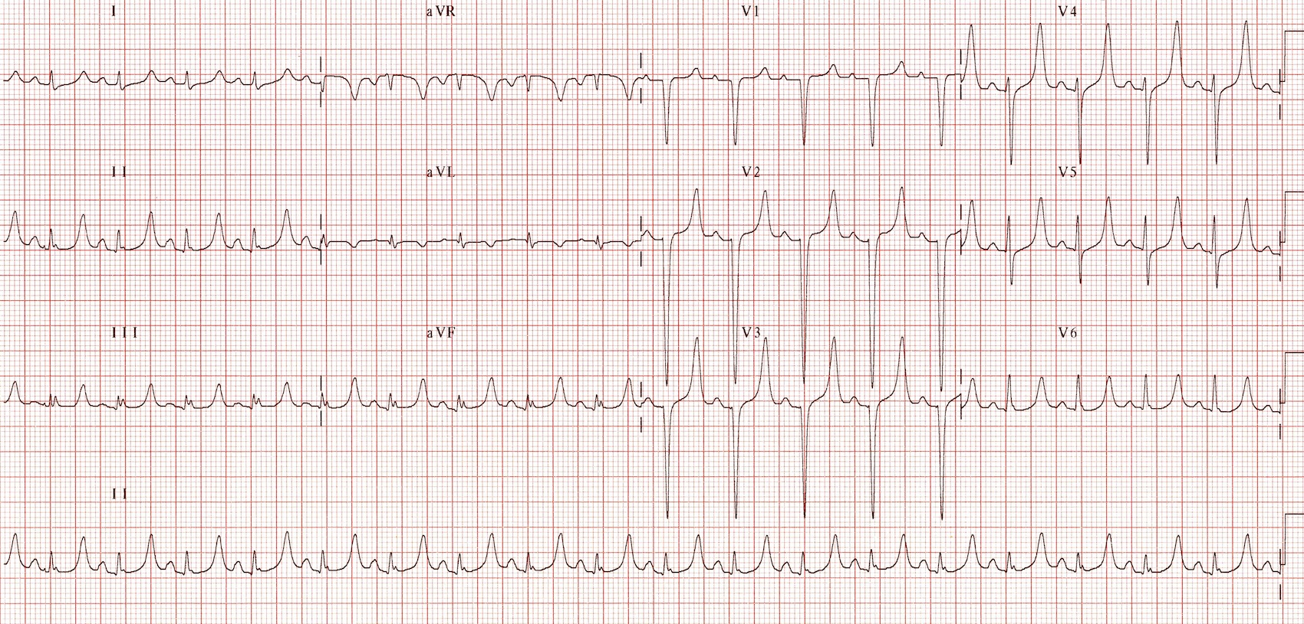
Hyperkalemia

Slide 32
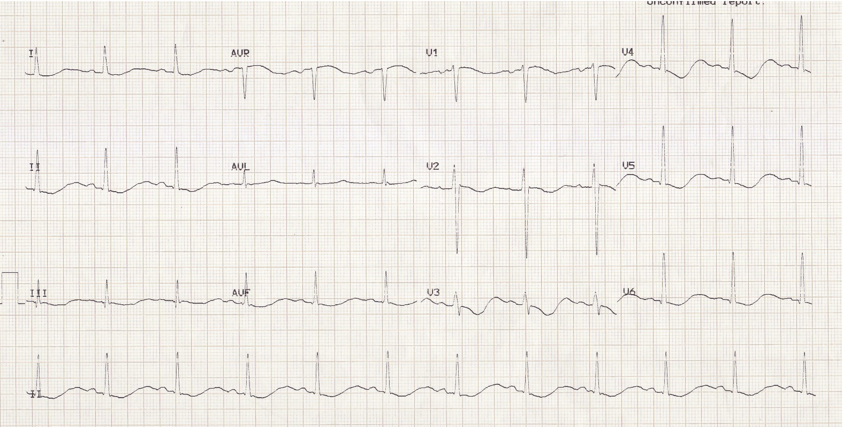
Hypokalemia

Slide 33
Treatment -Hyperkalemia
Stop K+ containing fluids
I.V.Calcium gluconate 2ml/kg
Insulin infusion-0.1U/kg/hr with Dextrose
K+ Exchange resins – (watch Sodium)
Exchange transfusion
Peritoneal Dialysis

Slide 34
Special Circumstances
R D S - Adequate fluids
Not excessive
B P D - Restrict fluids
↑ Calories
P D A - Restrict fluids
? Medications

Slide 35
Special situations –contd
Asphyxia - Restrict initially
? ATN ? SIADH
N E C -- More fluids
A R F - 400 ml / m2 + Urine output

Slide 36
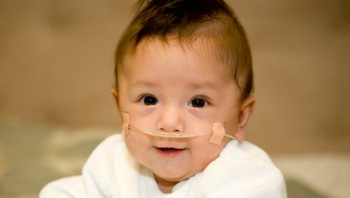

Slide 37
References
Medscape
Neo rev
UpTo Date
AIIMS protocol

Slide 40

Thank you !

