Slide 1
DYSELECTROLYTEMIA-CARDIOVASCULAR EFFECTS
DR.MALLESH.K.MD,DNB,DM[CARDIOLOGY]
CONSULTANT CARDIOLOGIST
PROFESSOR OF PAEDIATRICS
BMCRI

Slide 2
PREVALENCE OF ELECTROLYTE ABNORMALITIES IN PICU
Mild hypokalemia (3-3.4 mmol/L),mod hypokalemia affected 24% and 16% of the admissions respectively. Mild hyperkalemia (5.1-6.0 mmol/L) and mod hyperkalemia(>6meq/L) affected 17% and 12@%of the admissions
J Intensive Care Med. 2014 Sep-Oct;29(5):269-74. i:10.1177/0885066613491708. Epub 2013 Jun 6.
Sodium imbalance in 37% of PICU admissions in one study Jayakumar B et al. Int J Res Med Sci. 2017 Jun;5(6):2546-2551
17 of 70 critically ill patients in one study (24.29%) were hypomagnesemic and three patients were hypermagnesemic. a/w hypokalemia (58.82%), hyponatremia (47.05%), hypocalcemia (70.58%) and hypophosphatemia (29.41%). Mortality of hypomagnesemic group was 74.47% while that of normomagnesemic group was 36% (P = 0.004). Int J Appl Basic Med Res. 2014 Jan-Jun; 4(1): 34–37

Slide 3
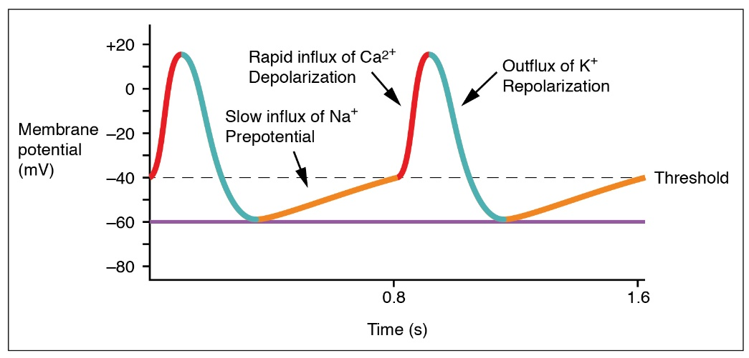
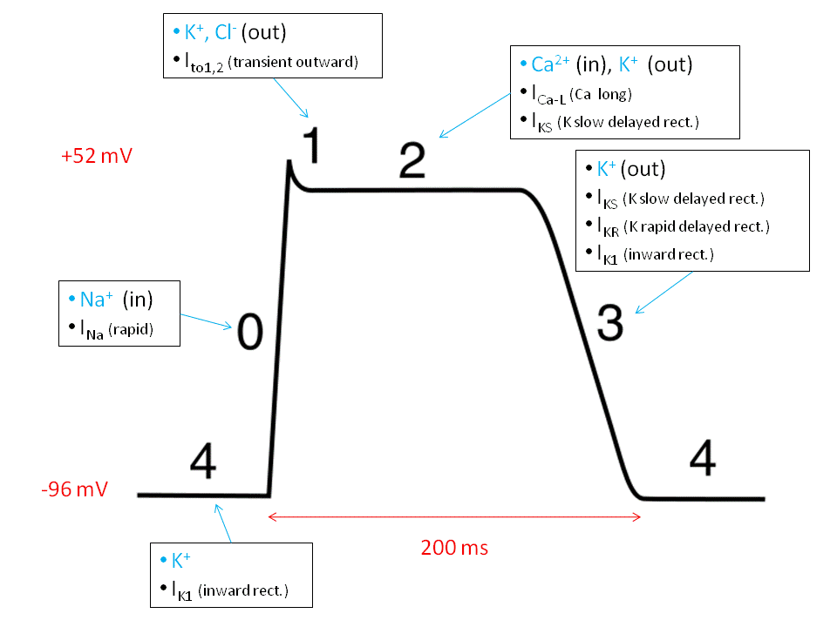
ROLE OF ELECTROLYTES IN RMP AND ACTION POTENTIAL

Slide 4
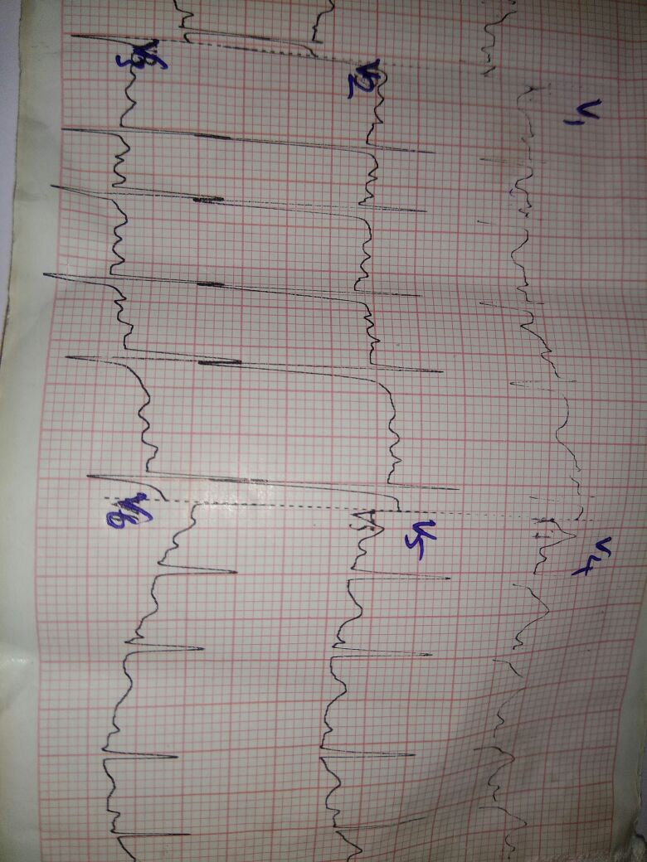
HYPOKALEMIA

Slide 5
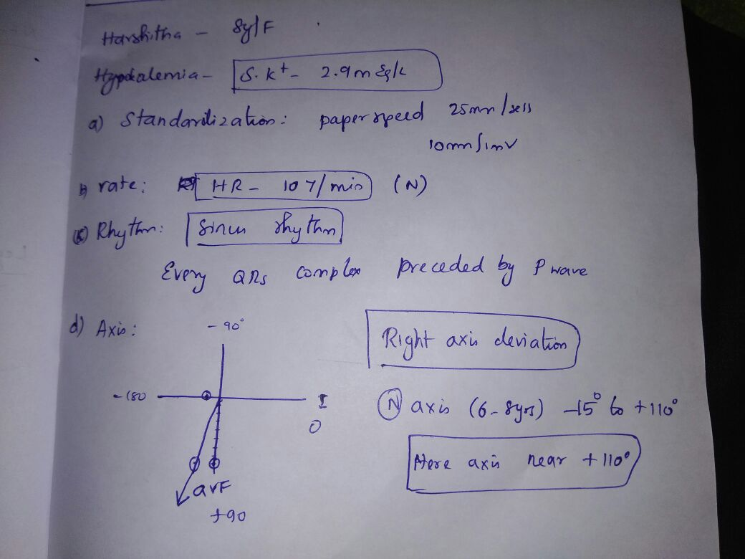
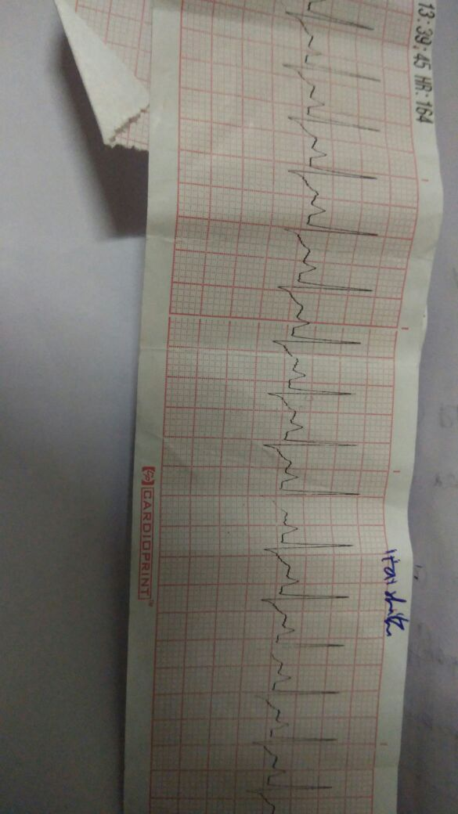
HYPOKALEMIA

Slide 6
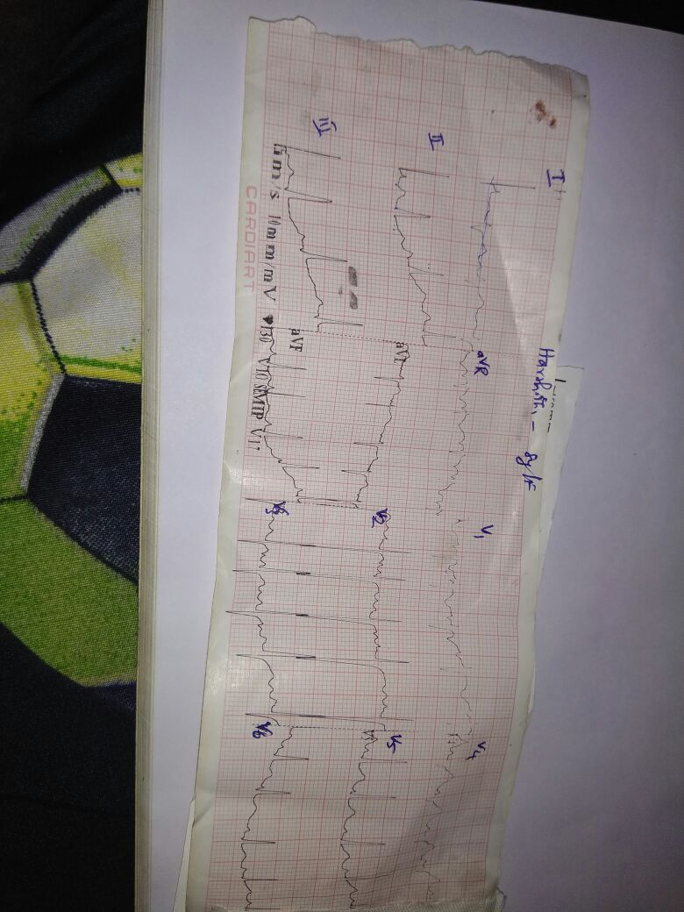
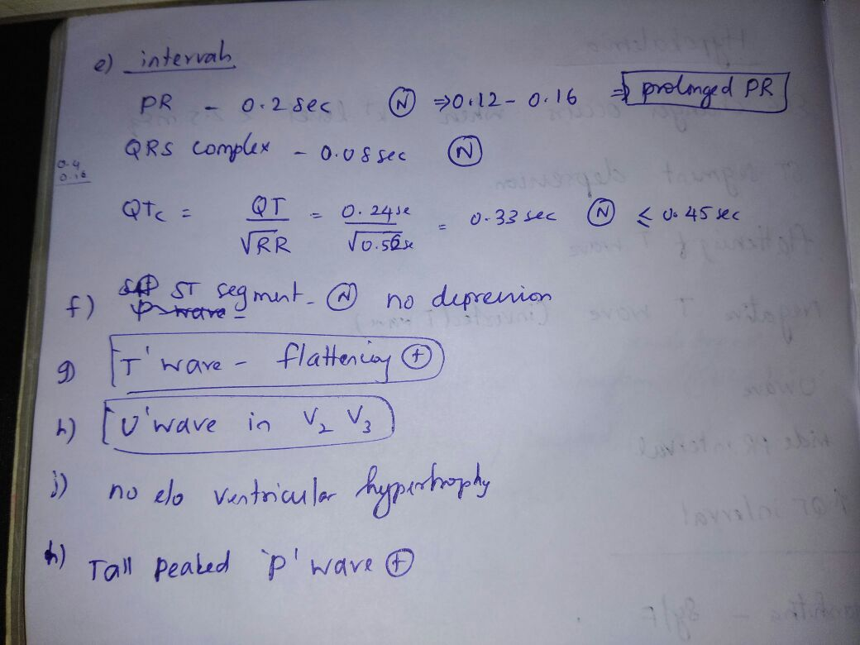
HYPOKALEMIA

Slide 7
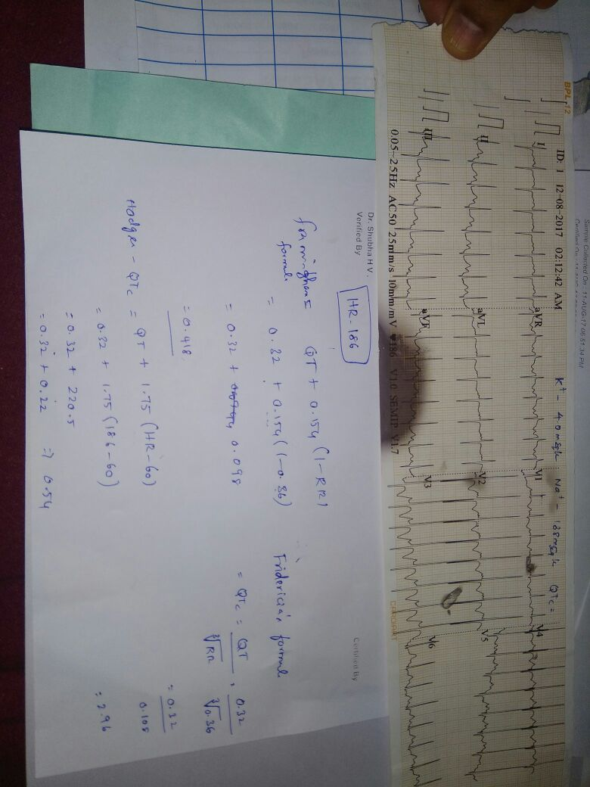
HYPOKALEMIA

Slide 8
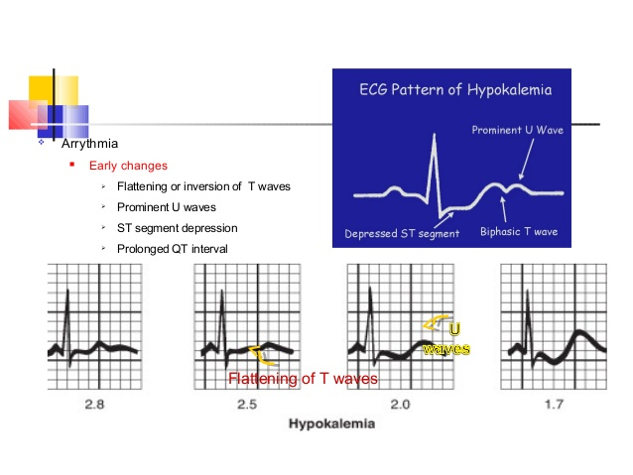
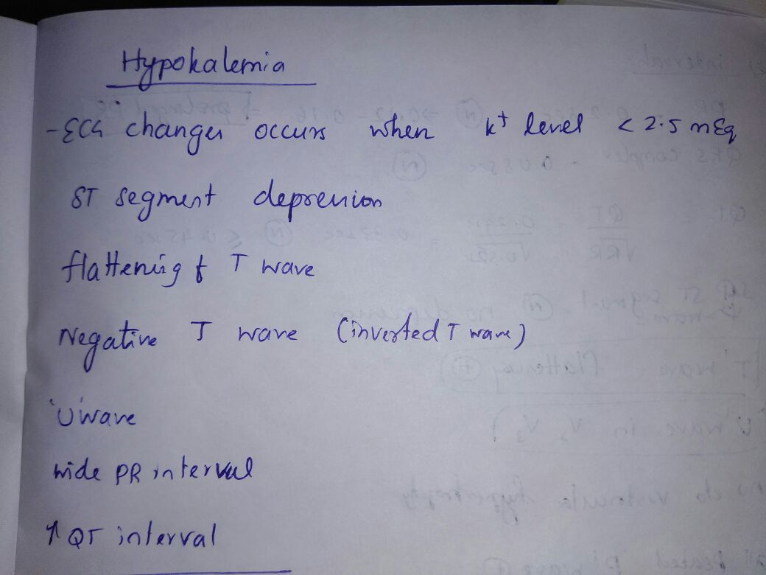

Slide 9
QT
Causes of long QT
Hypokalaemia
Hypomagnesaemia
Hypocalcaemia
Hypothermia
Myocardial ischemia
Post-cardiac arrest
Raised intracranial pressure
Congenital long QT syndrome
DRUGS
Bazett’s formula: QT_{C} = QT / √ RR
Fredericia’s formula: QT_{C} = QT / RR ^{1/3}
Framingham formula: QT_{C} = QT + 0.154 (1 – RR)
Hodges formula: QT_{C} = QT + 1.75 (heart rate – 60)

Slide 10
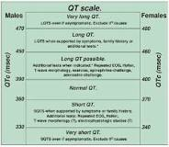
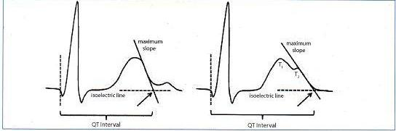
QT

Slide 11
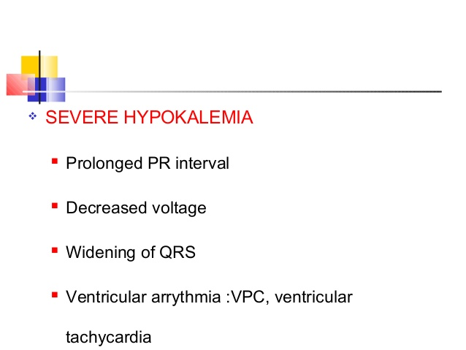

Slide 12
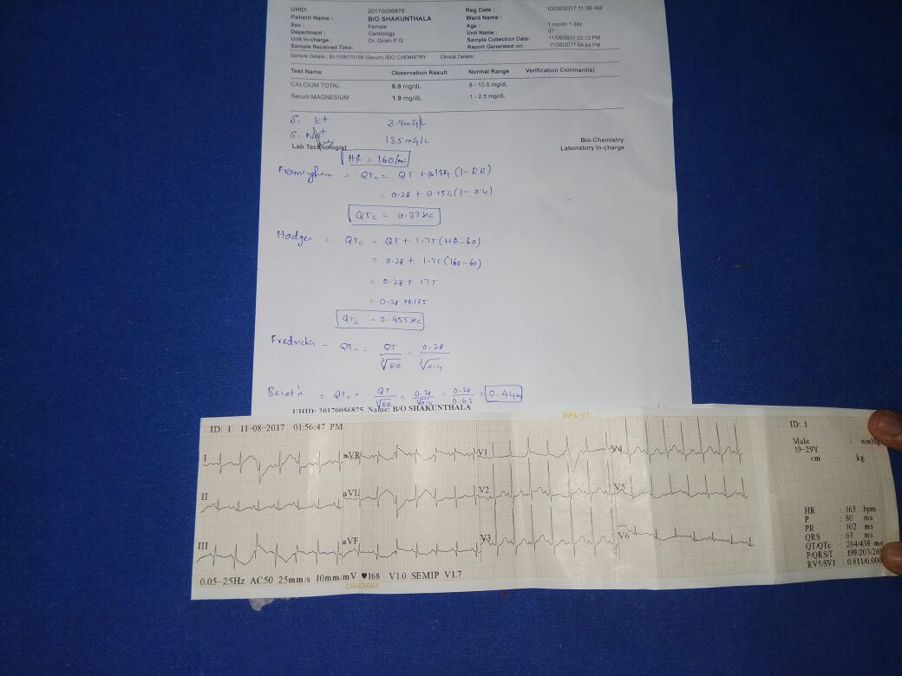
HYPOKALEMIA

Slide 13
QT
The normal range for the rate-corrected QT interval is similar in males and females from birth until late adolescence (0.37 to 0.44 sec). In adults, females have slightly longer QT intervals than males. A corrected QT interval of more than 0.45 sec is considered prolonged in men; the normal range generally is extended to 0.45 to 0.47 seconds in women (table 2) [10]. (See 'Diagnosis' below.)

Slide 14
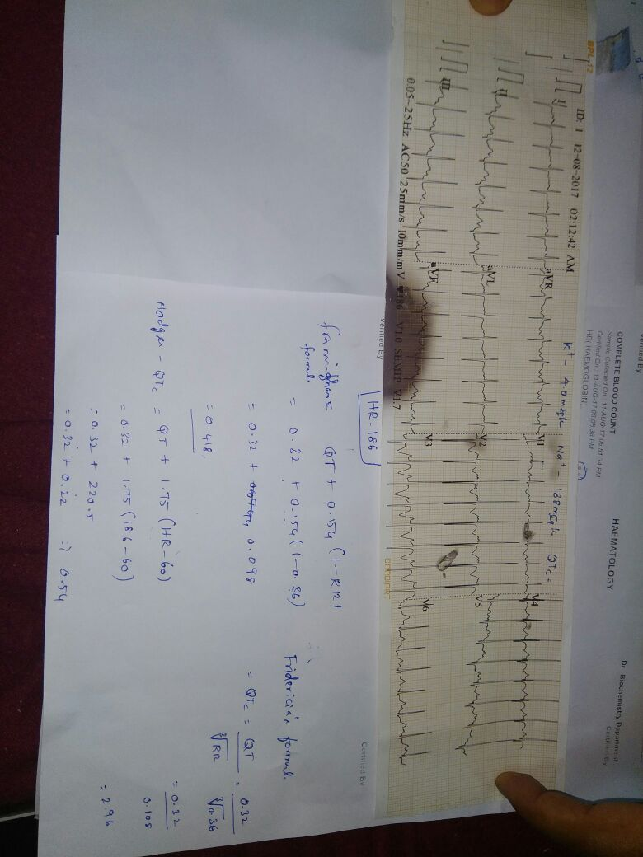

Slide 15
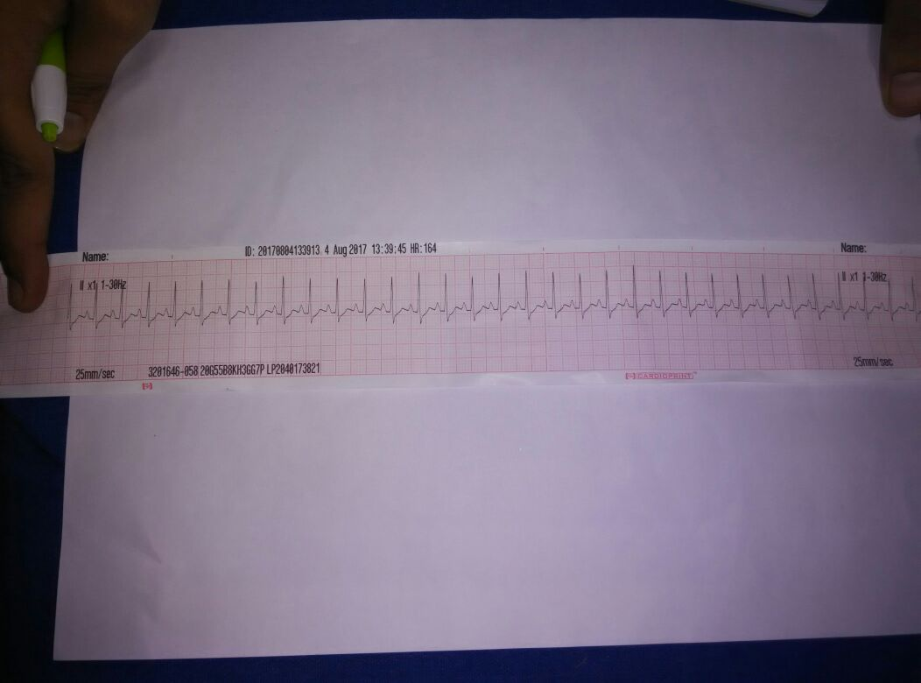
HYPOKALEMIA

Slide 16
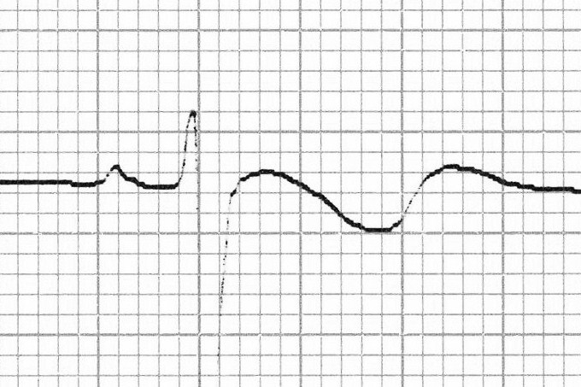
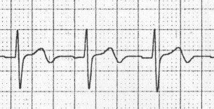
ISCHAEMIA
HYPOKALEMIA

Slide 17
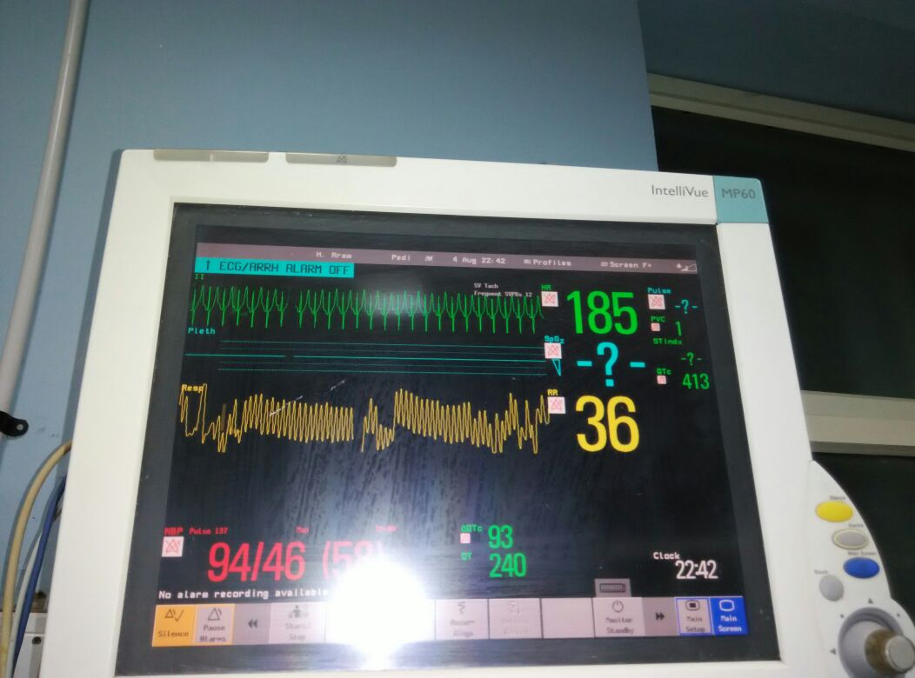
HYPERKALEMIA

Slide 18
HYPERKALEMIA
5.5 mEq/L (repolarization abnormalities): Peaked T waves (usually the earliest sign of hyperkalaemia)
> 6.5 mEq/L ( progressive paralysis of the atria):P wave widens and flattens,PR segment lengthens,P disappear
> 7.0 mEq/L9conduction abnormalities and bradycardia:
Prolonged QRS interval with bizarre QRS morphology
High-grade AV block with slow JR,IVR
Any kind of conduction block (bundle branch blocks, fascicular blocks)
Sinus bradycardia or slow A sine wave appearance (a pre-terminal rhythm)
> 9.0 mEq/L ( cardiac arrest ):Asystole,Ventricular fibrillation,PEA with bizarre, wide complex rhythm

Slide 19
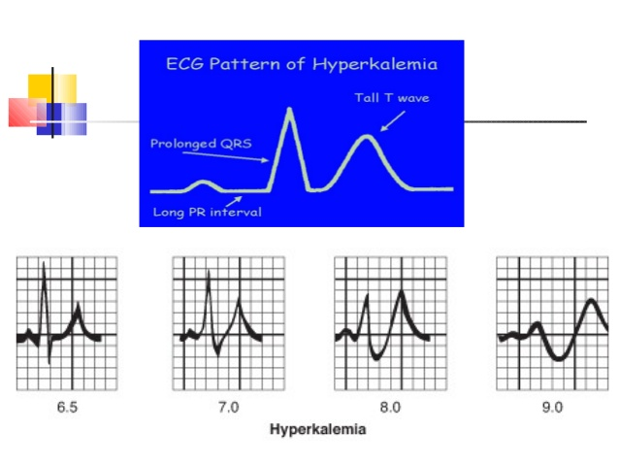

Slide 20
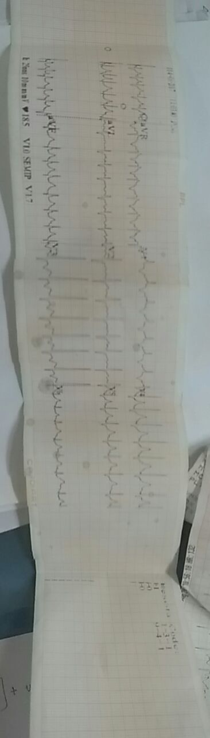
HYPERKALEMIA

Slide 21
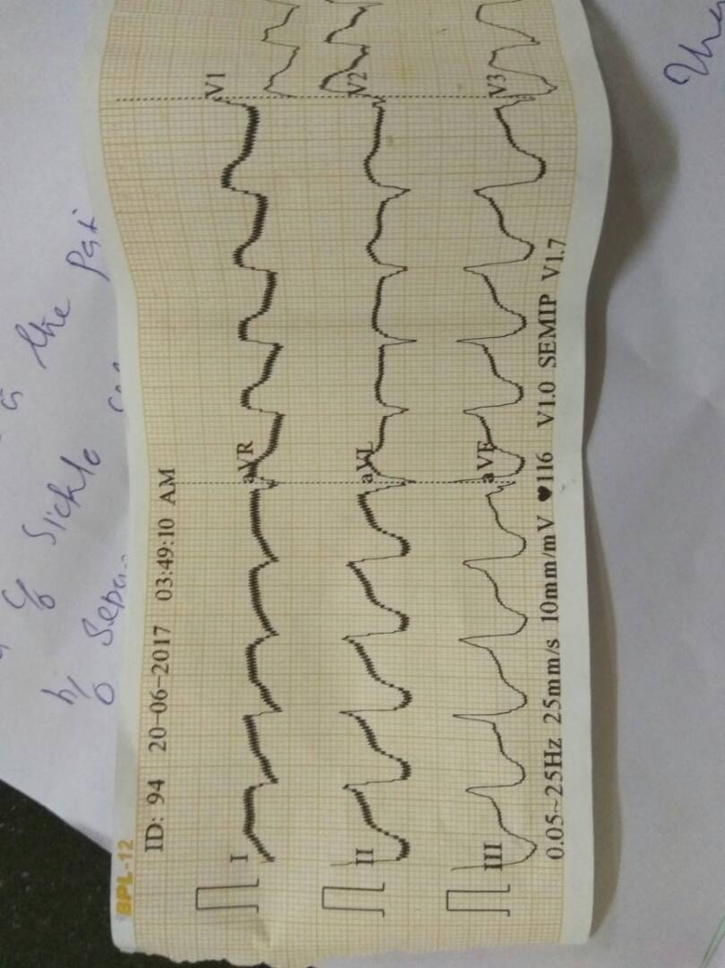
HYPERKALEMIA

Slide 22
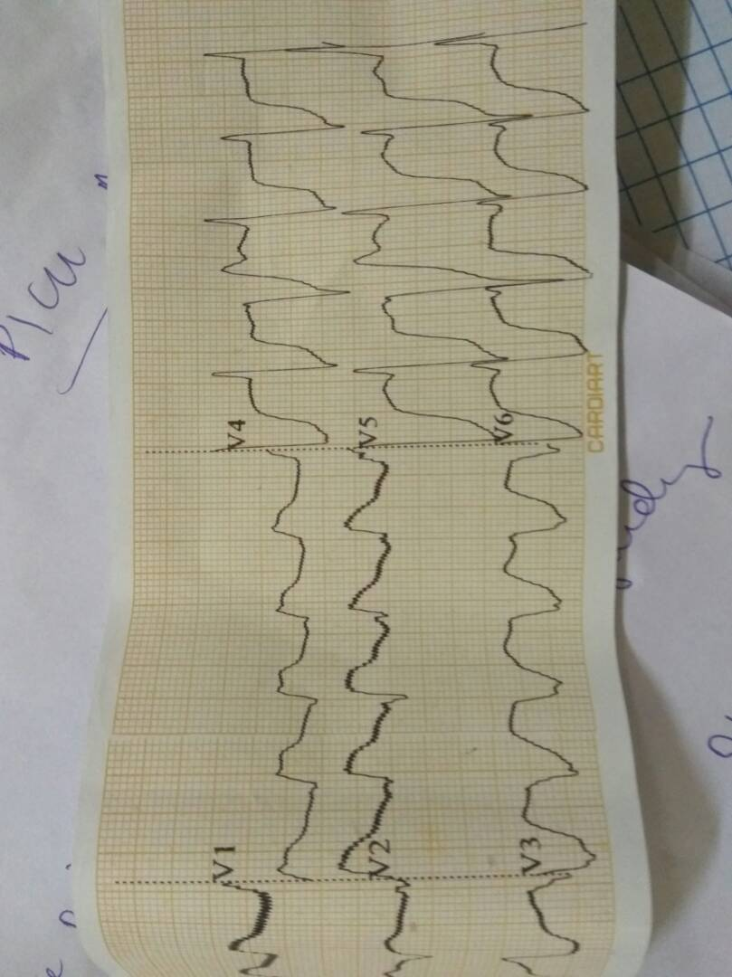
HYPERKALEMIA

Slide 23
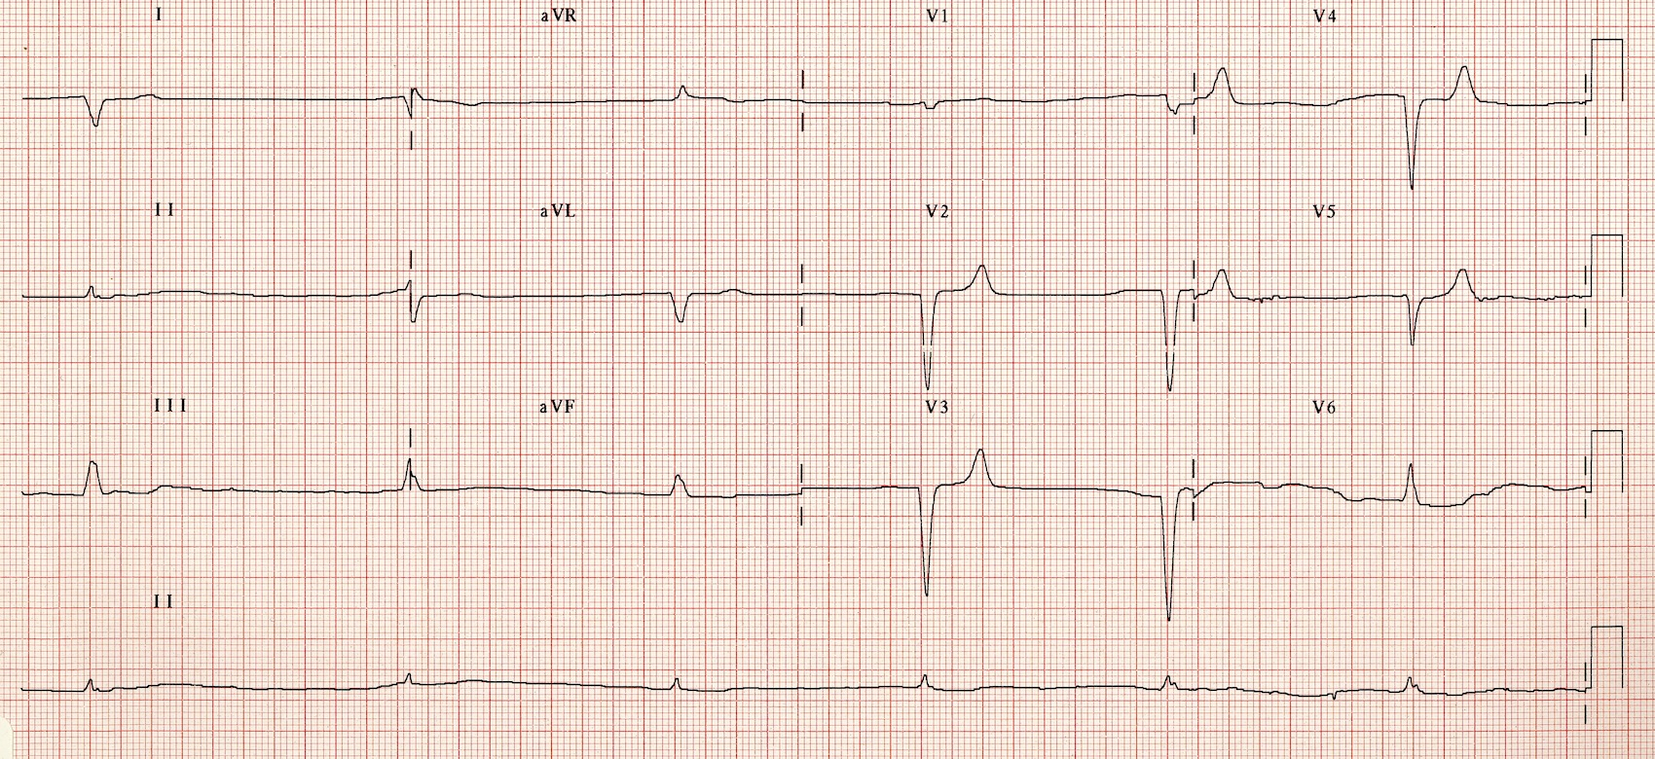
HYPERKALEMIA
ADVANCED AV BLOCK CAN OCCUR WITH HYPERKALEMIA HYPERMAGNESEMIA
METABOLIC ACIDOSIS POSSIBLY SEVERE HYPONATREMIA Heart India / Volume 5 / Issue 2 / April-June 2017
Notes:
SLOW JR IN HYPERKALEMIA

Slide 24
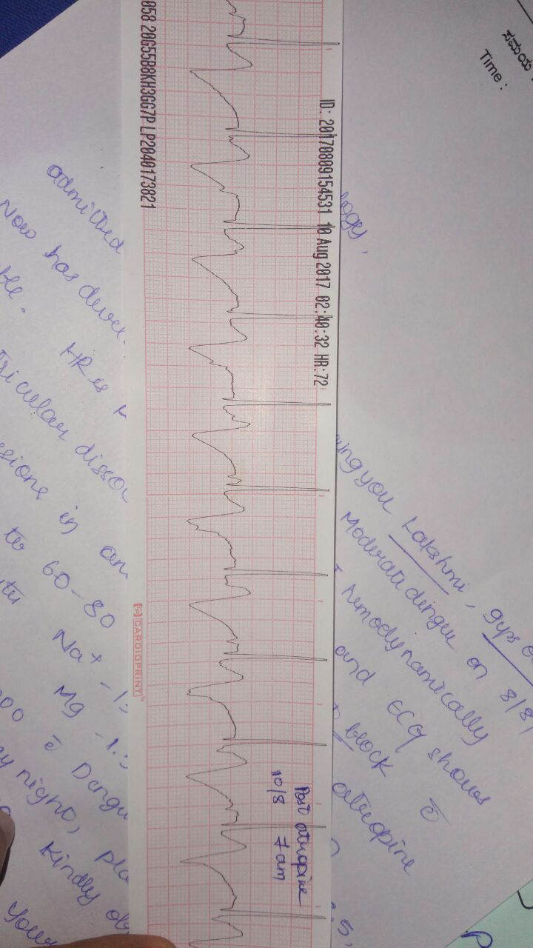
Post atropine

Slide 25
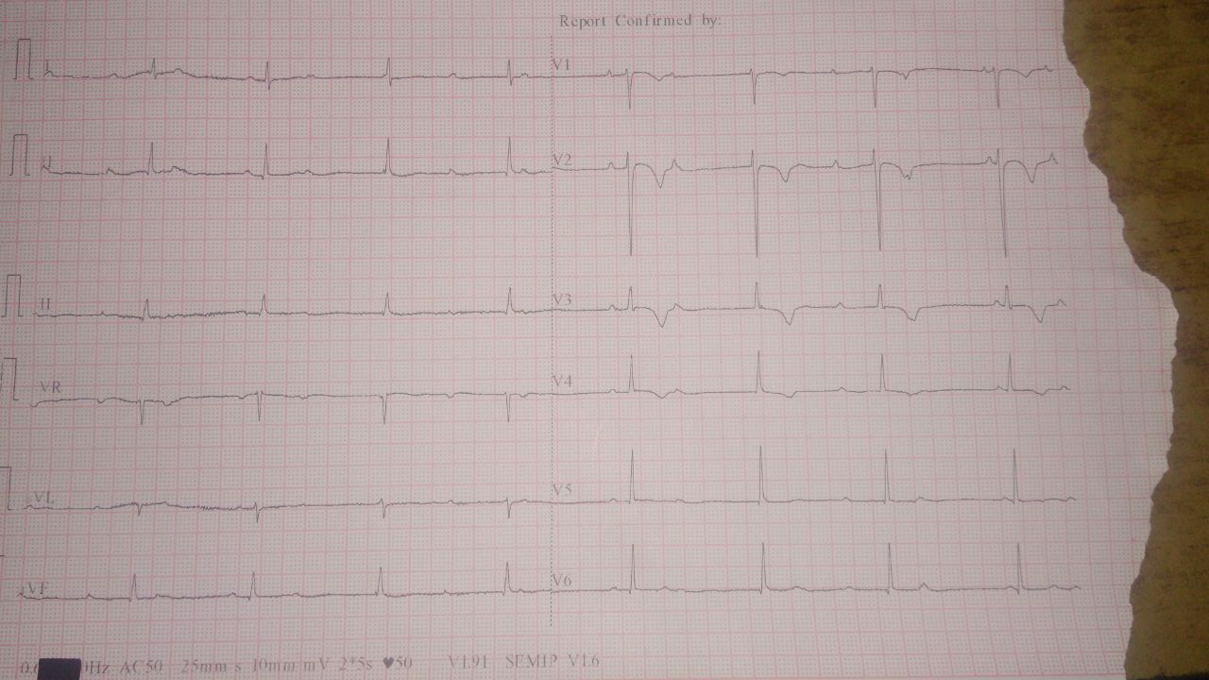

Slide 26
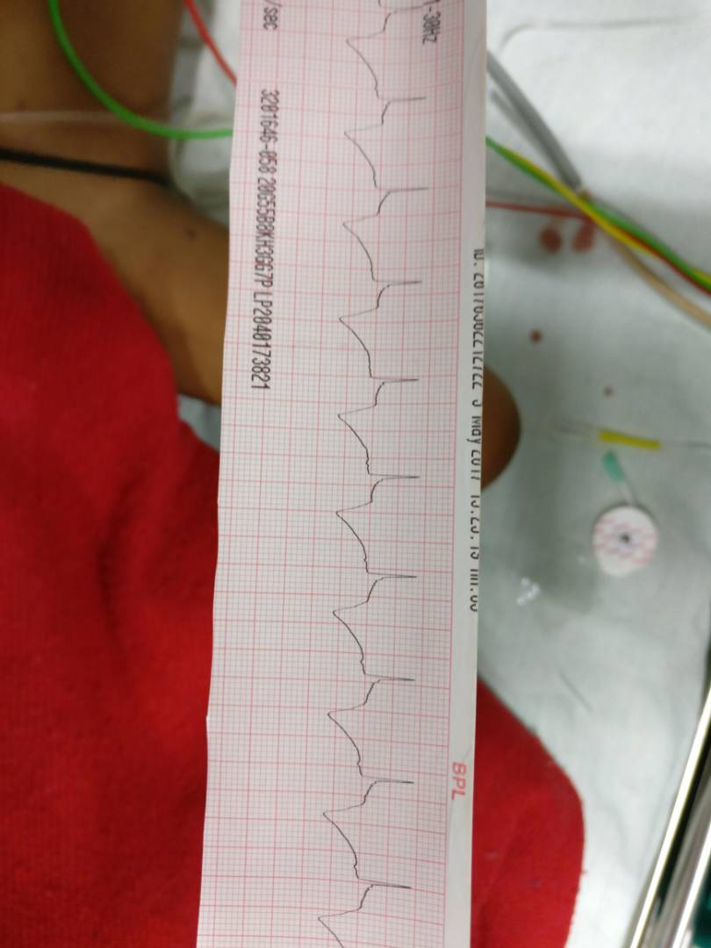

Slide 27
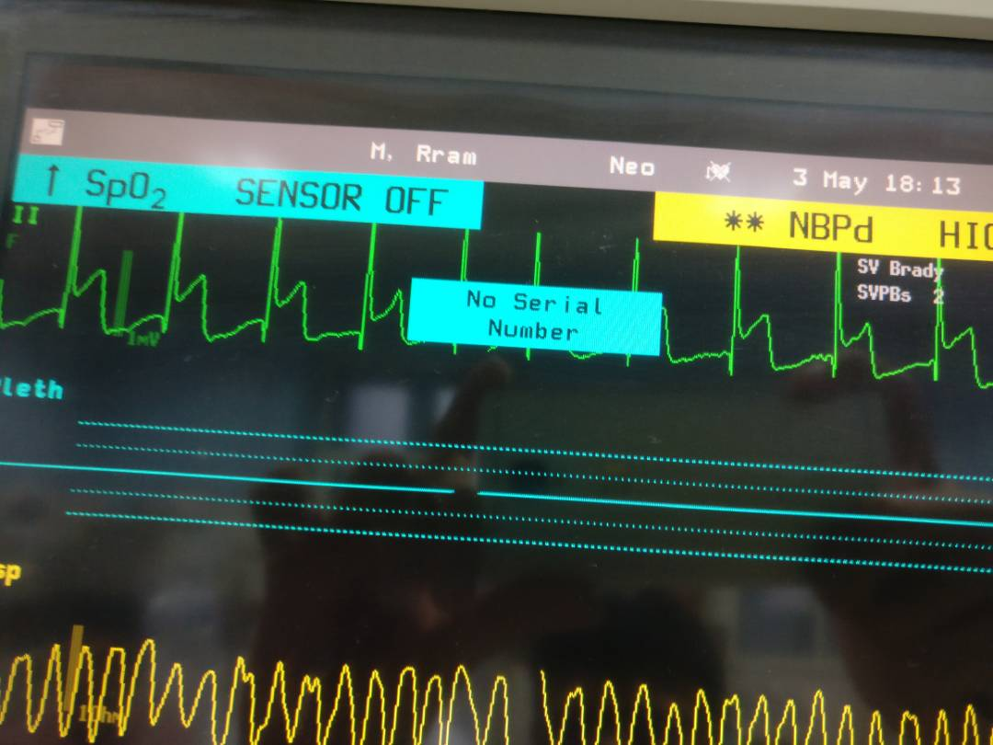
HYPERKALEMIA

Slide 28
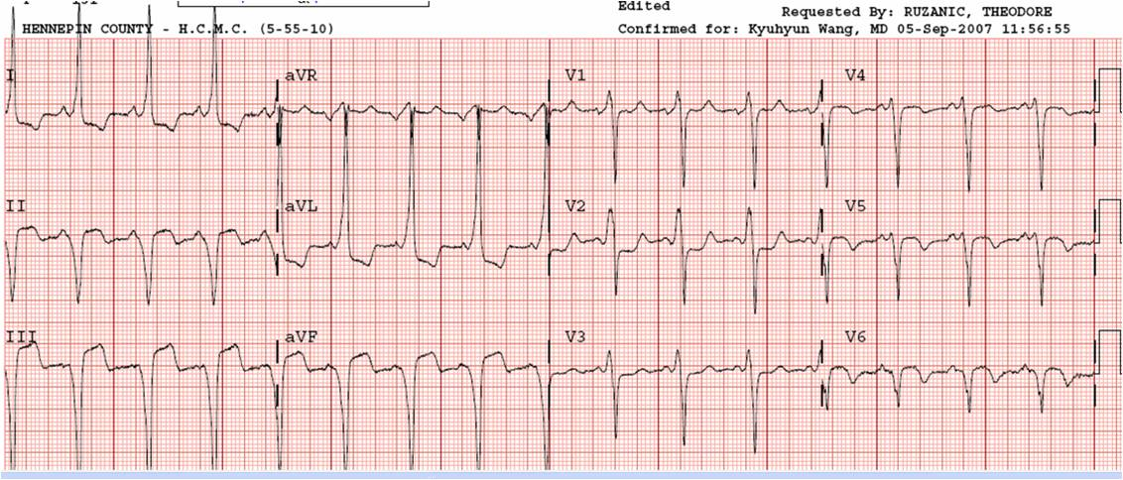
HYPERKALEMIA

Slide 29
HYPOMAGNESEMIA
Congestive cardiac failure
Ventricular arrhythmias
Long QT syndromes
Progression Atheros sclerosis
Reactive coronary arteries-neuro hormanal/electrolyte
Hypokalemia and calcium induced post ischaemic damage
Hypercoagulability --magnesium inhibits coagulation factors (protrombin, thrombin, V, VII, IX). ,inhibits platelet aggregation
Hypertension –esperimental studies only with out epidemiological sup secondary HTN-Eclampsia,alcohol with drawl HTN

Slide 30
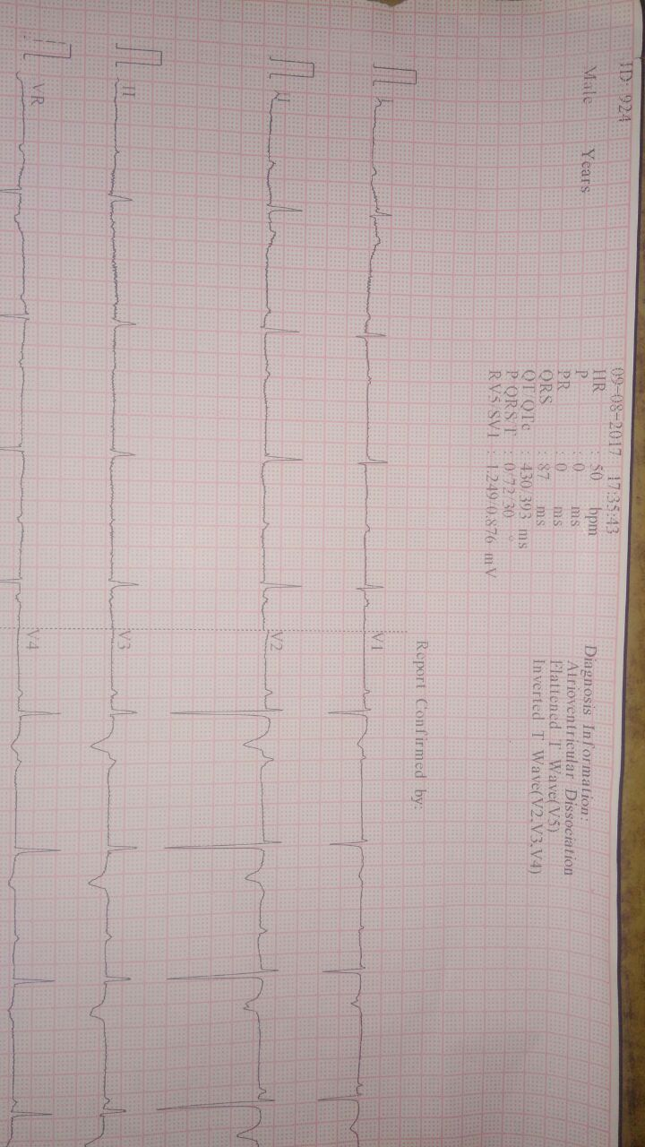
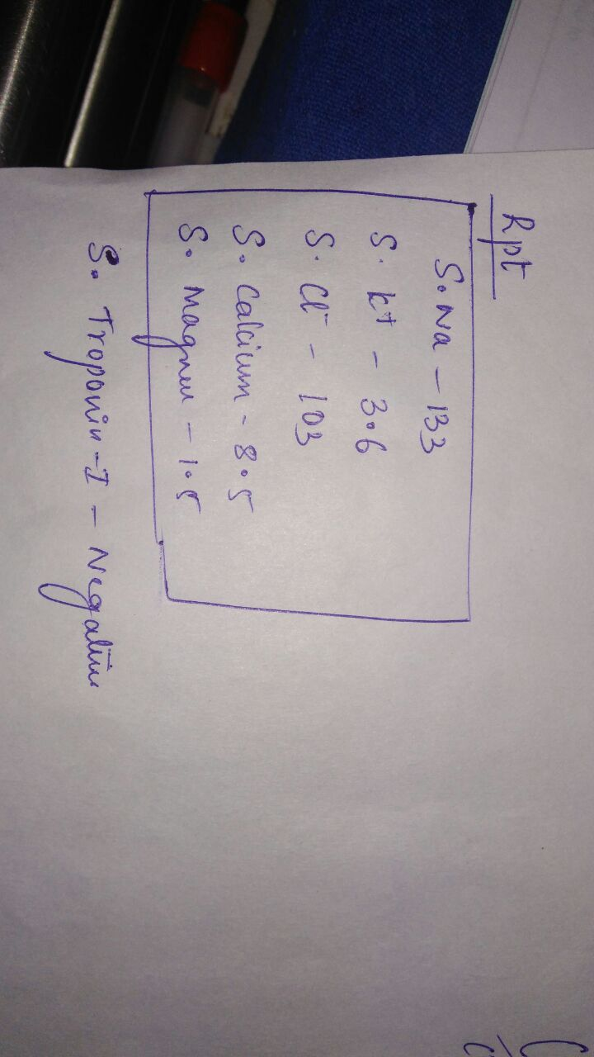

Slide 31
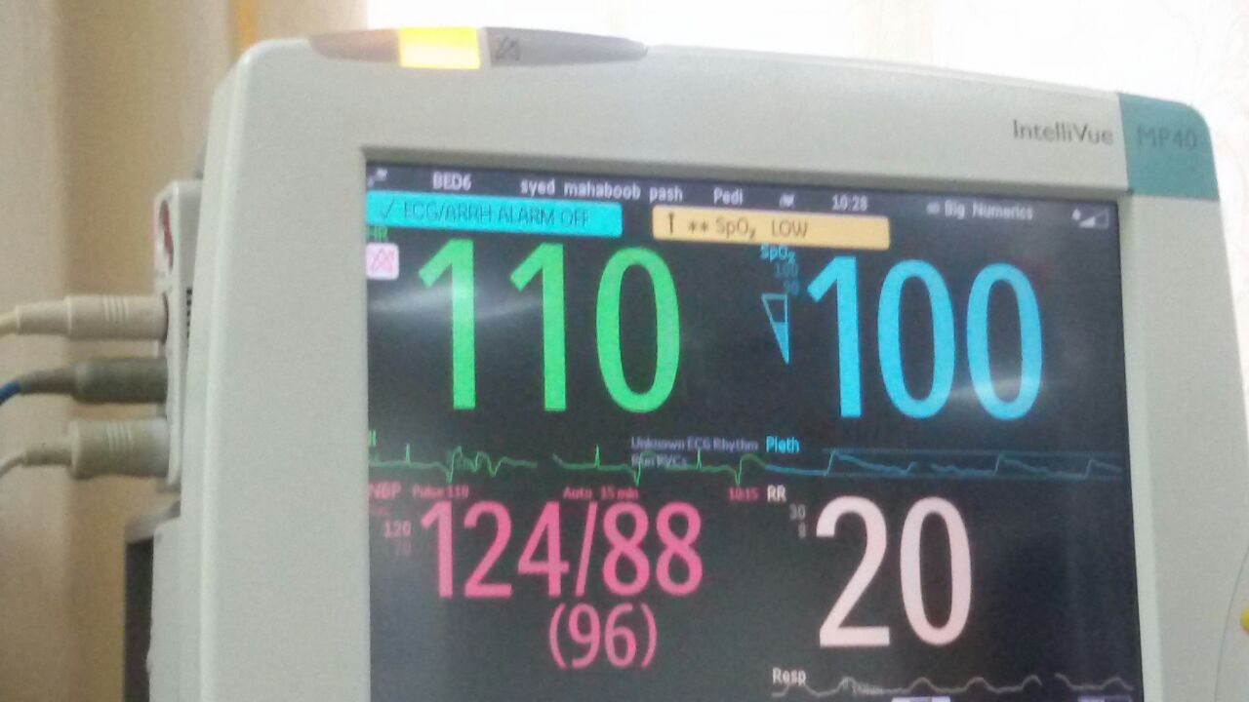
HYPOMAGNESEMIA

Slide 32
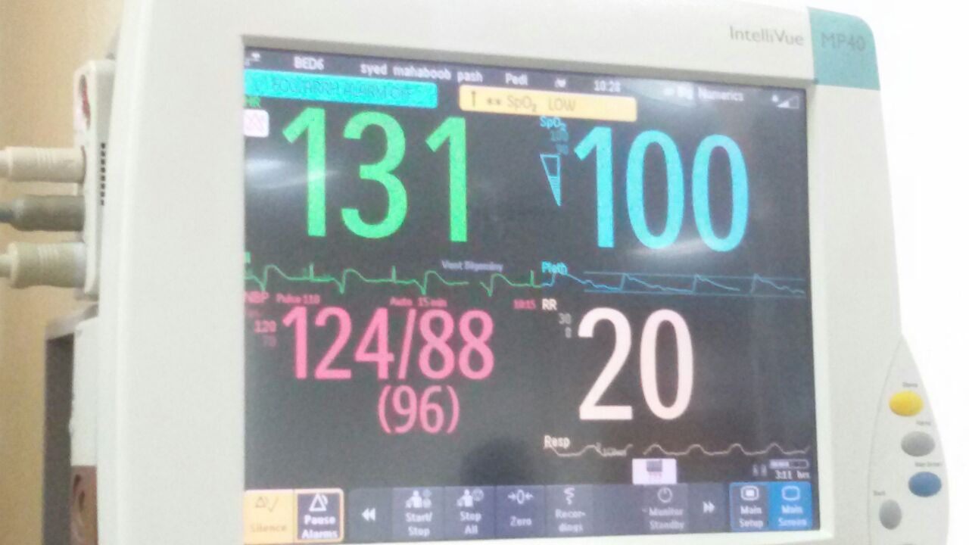

Slide 33
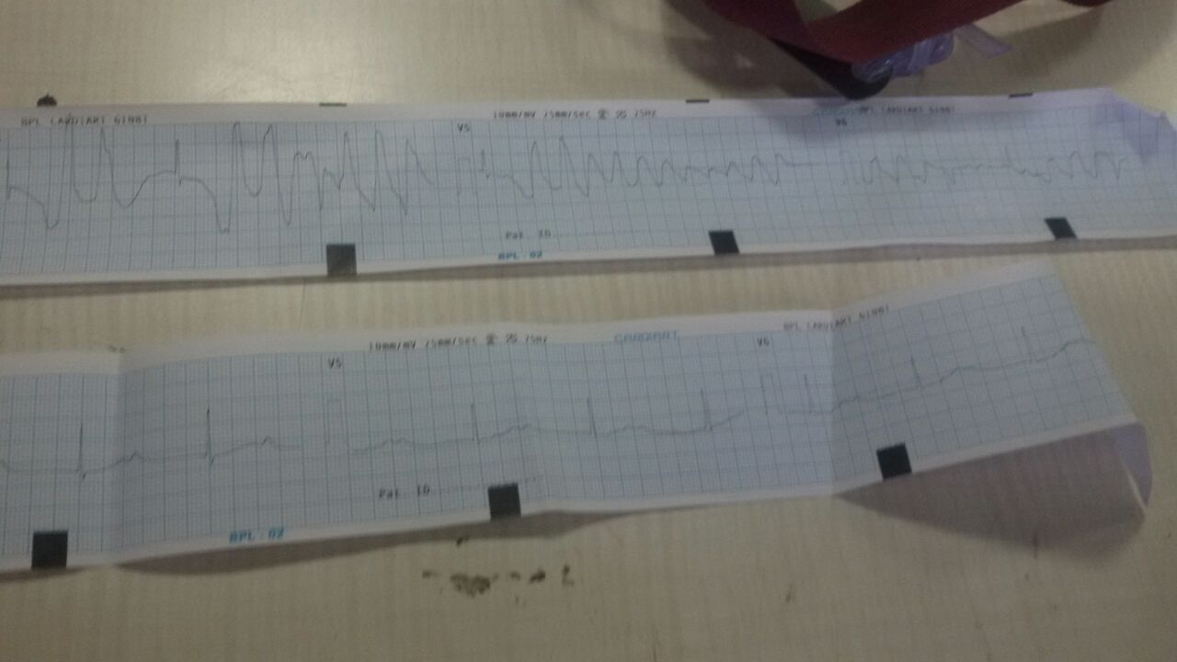
HYPOMAGNESEMIA

Slide 34
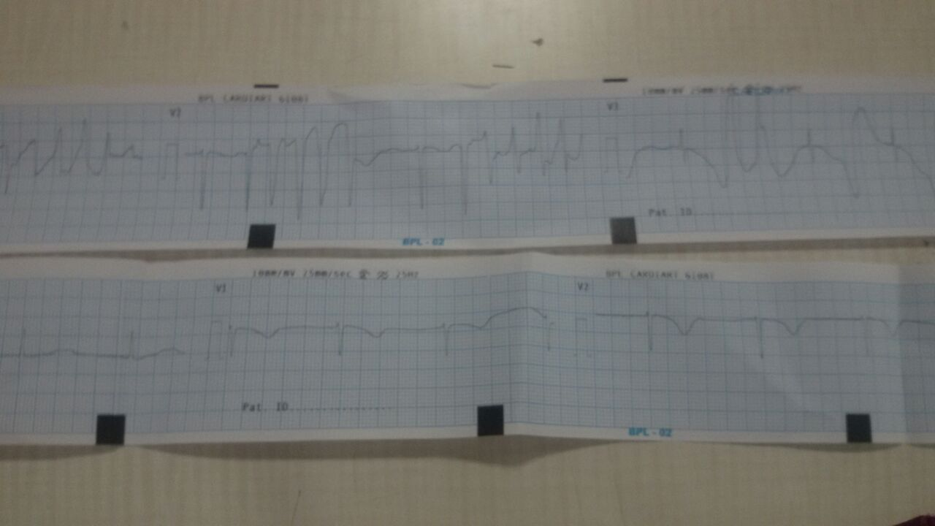

Slide 35
HYPERMAGNESEMIA
Severe hypermagnesemia presenting with abnormal electrocardiographic findings similar to those of hyperkalemia
Sometimes may co exist with hyperkalemia
Treatment - hemodialysis with dialysate containing 2.0 mEq/L (2.4 mg/dL) of magnesium,.
An ECG normal sinus rhythm with mild T wave changes at less than 5mg/dL

Slide 36
HYPERMAGNESEMIA
@ 6–12 mg/dL (5–10 mEq/L) - ECG changes, prolongation of the PR interval, increased duration of QRS complex, prolonged QT interval, delayed IVC, and tall T wave.
@ 9–12 mg/Dl-- somnolence, loss of DTR, and hypotension, and concentrations >12 mg/dL (10 mEq/L) may result in sinoatrial and atrioventricular block, ventricular arrhythmias, muscle paralysis, hypoventilation, and stupor.
> 15.6 mg/dL (13 mEq/L)-- asystole, coma and respiratory arrest
Korean J Pediatr 20013;56(7):308-311

Slide 37
HYPERCALCEMIA
Hypercalcemia, acute and chronic, irrespective of the cause, is known to have effects on the heart and the vascular system that are potentially life-threatening. Some of these effects include accelerated atherosclerosis, uncontrolled hypertension, structural effects, and progressive cardiac dysfunction. Heart Metab. 2006;30:25–29

Slide 38
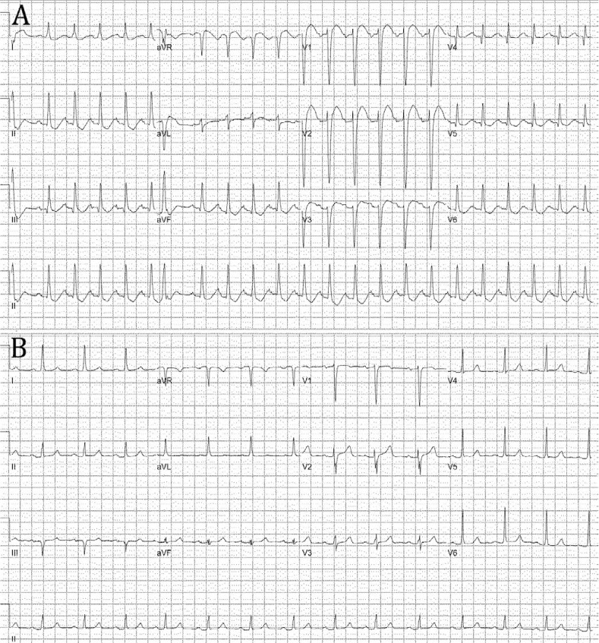
HYPERCALCEMIA PSEUDOINFARCTION PATTERN

Slide 39
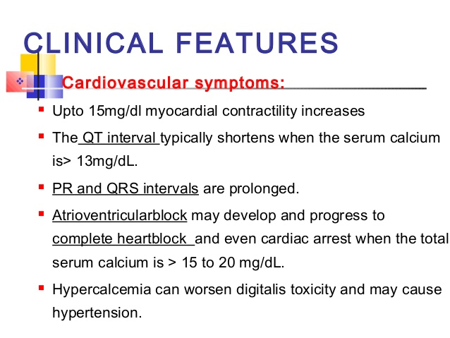

Slide 40
The four causes of a short QT interval:
Hypercalcemia
Digitalis
Thyrotoxicosis
Increased sympathetic tone
Mild hypercalcemia —asymptomaticor12 mg/dL -no immediate treatment.
Moderate hypercalcemia — Asymptomatic or 12-14 mg/dL precautions+bisphosphonates
Severe hypercalcemia — >14 mg/dL (3.5 mmol/L) Immediate therapy —3 Pronged approach ●Volume expansion with isotonic saline No diuretics unless compelling indications●
calcitonin (4 IU/kg) and repeat measurement of serum calcium in several hours.). +bisphosphonate

Slide 41
HYPOCALCEMIA
The HHF can be precipitated by coexisting hypomagnesemia and underlying organic heart disease. Plasma total calcium level at the onset of HHF is extremely low, with range of 4-6 mg/dL after correction for plasma albumin.
Suspect when when deterioration CCF with furosemide
Confusing when multiple causes of heat failure present
some patients manifest with HHF alone although many with neurological symptoms.
After aggressive calcium supplementation, the HHF can be recovered completely within 3-4 weeks Acta Cardiol Sin 2009;25:4751

Slide 42
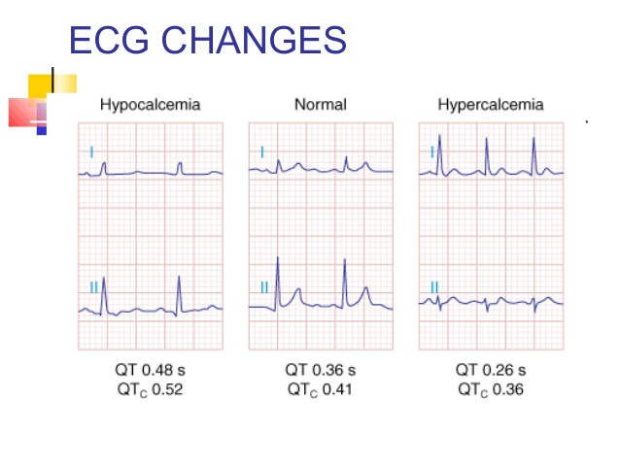

Slide 43
Hyponatremia and cardiovascular manifestation
Severe Hyponatremia Leading to Complete Atrioventricular Block
The American Journal of Medicine.Volume 129, Issue 10, October 2016, Pages e243-e24

Slide 44
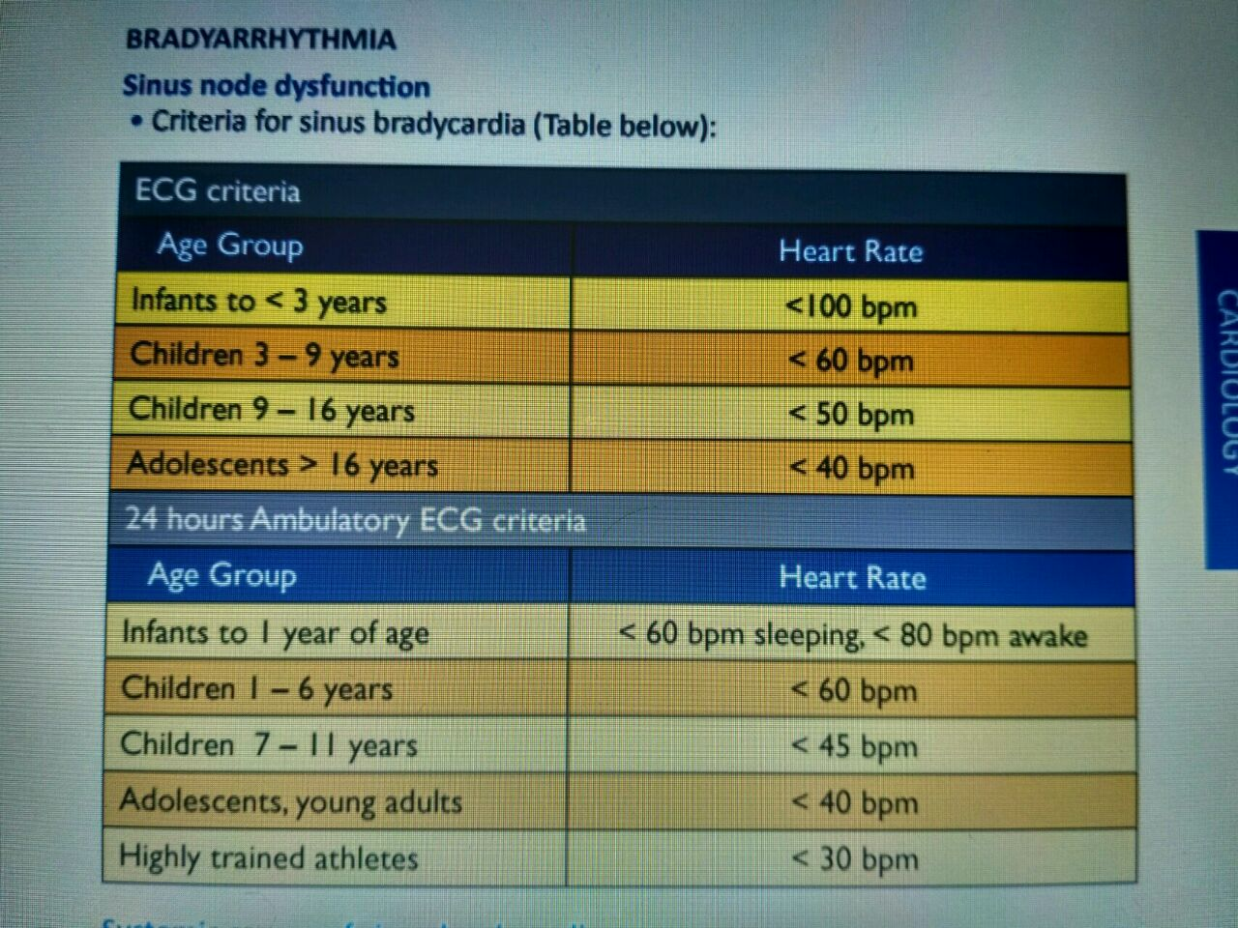
MANAGEMENT OF BRADY ARRHYTHMIAS

Slide 45
MANAGEMENT OF BRADY ARRHYTHMIAS
Acute Management: Symptomatic Bradycardia with Haemodynamic Instability • Treat the underlying systemic causes of bradycardia •
Drugs: • IV Atropine • IV Isoprenaline infusion • IV Adrenaline infusion • Transcutaneous pacing if available. •
Patients who are not responding to initial acute management should be referred to cardiologist for further management. •
Emergency transvenous pacing or permanent pacing may be required.

Slide 46
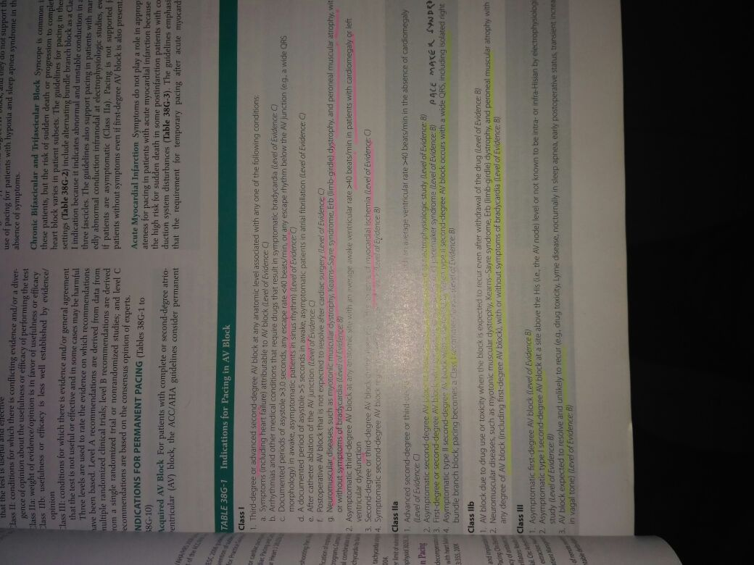
MANAGEMENT OF BRADY ARRHYTHMIA

Slide 47
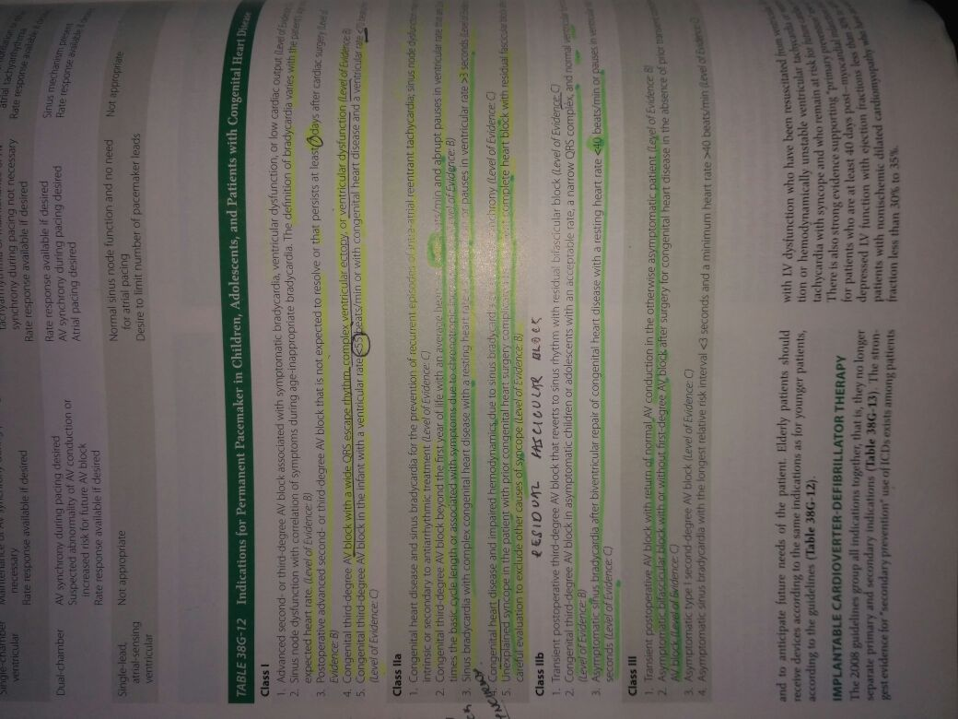
MANAGEMENT OF BRADY ARRHYTHMIA

Slide 48
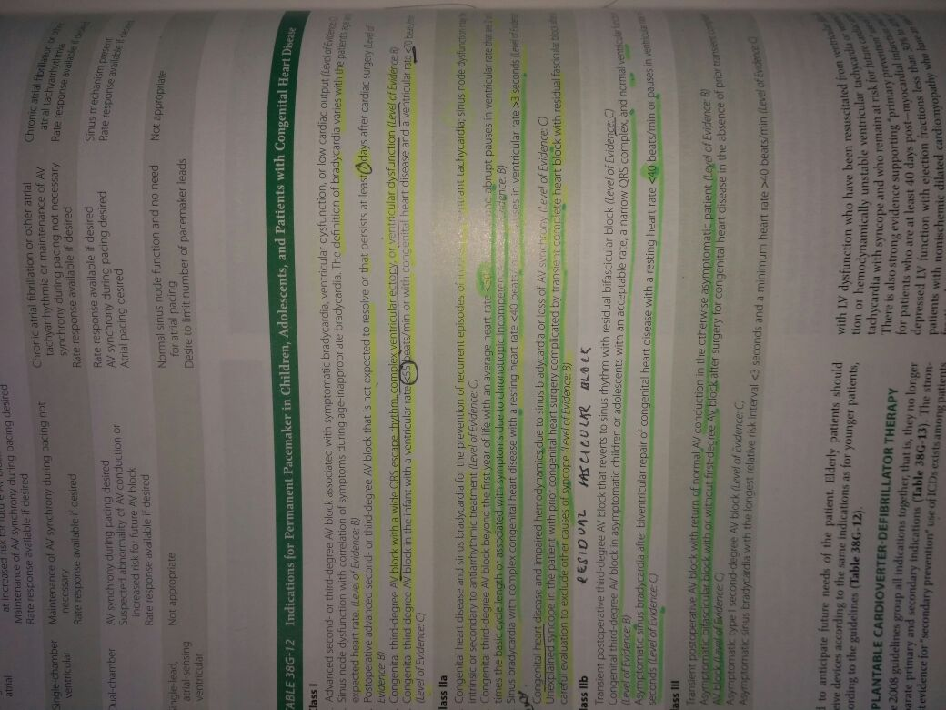
MANAGEMENT OF BRADY ARRHYTHMIA

Slide 49
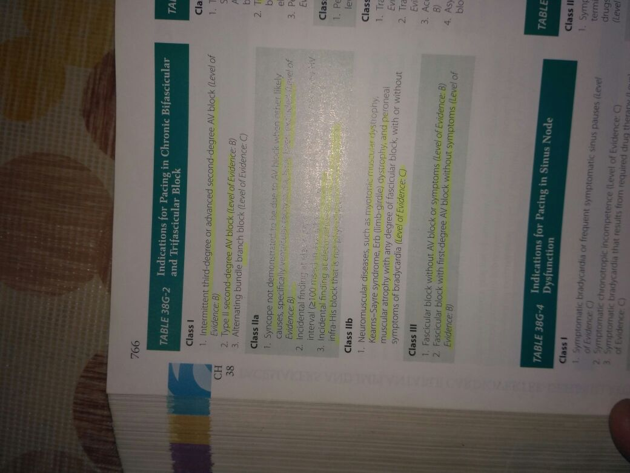

Slide 50
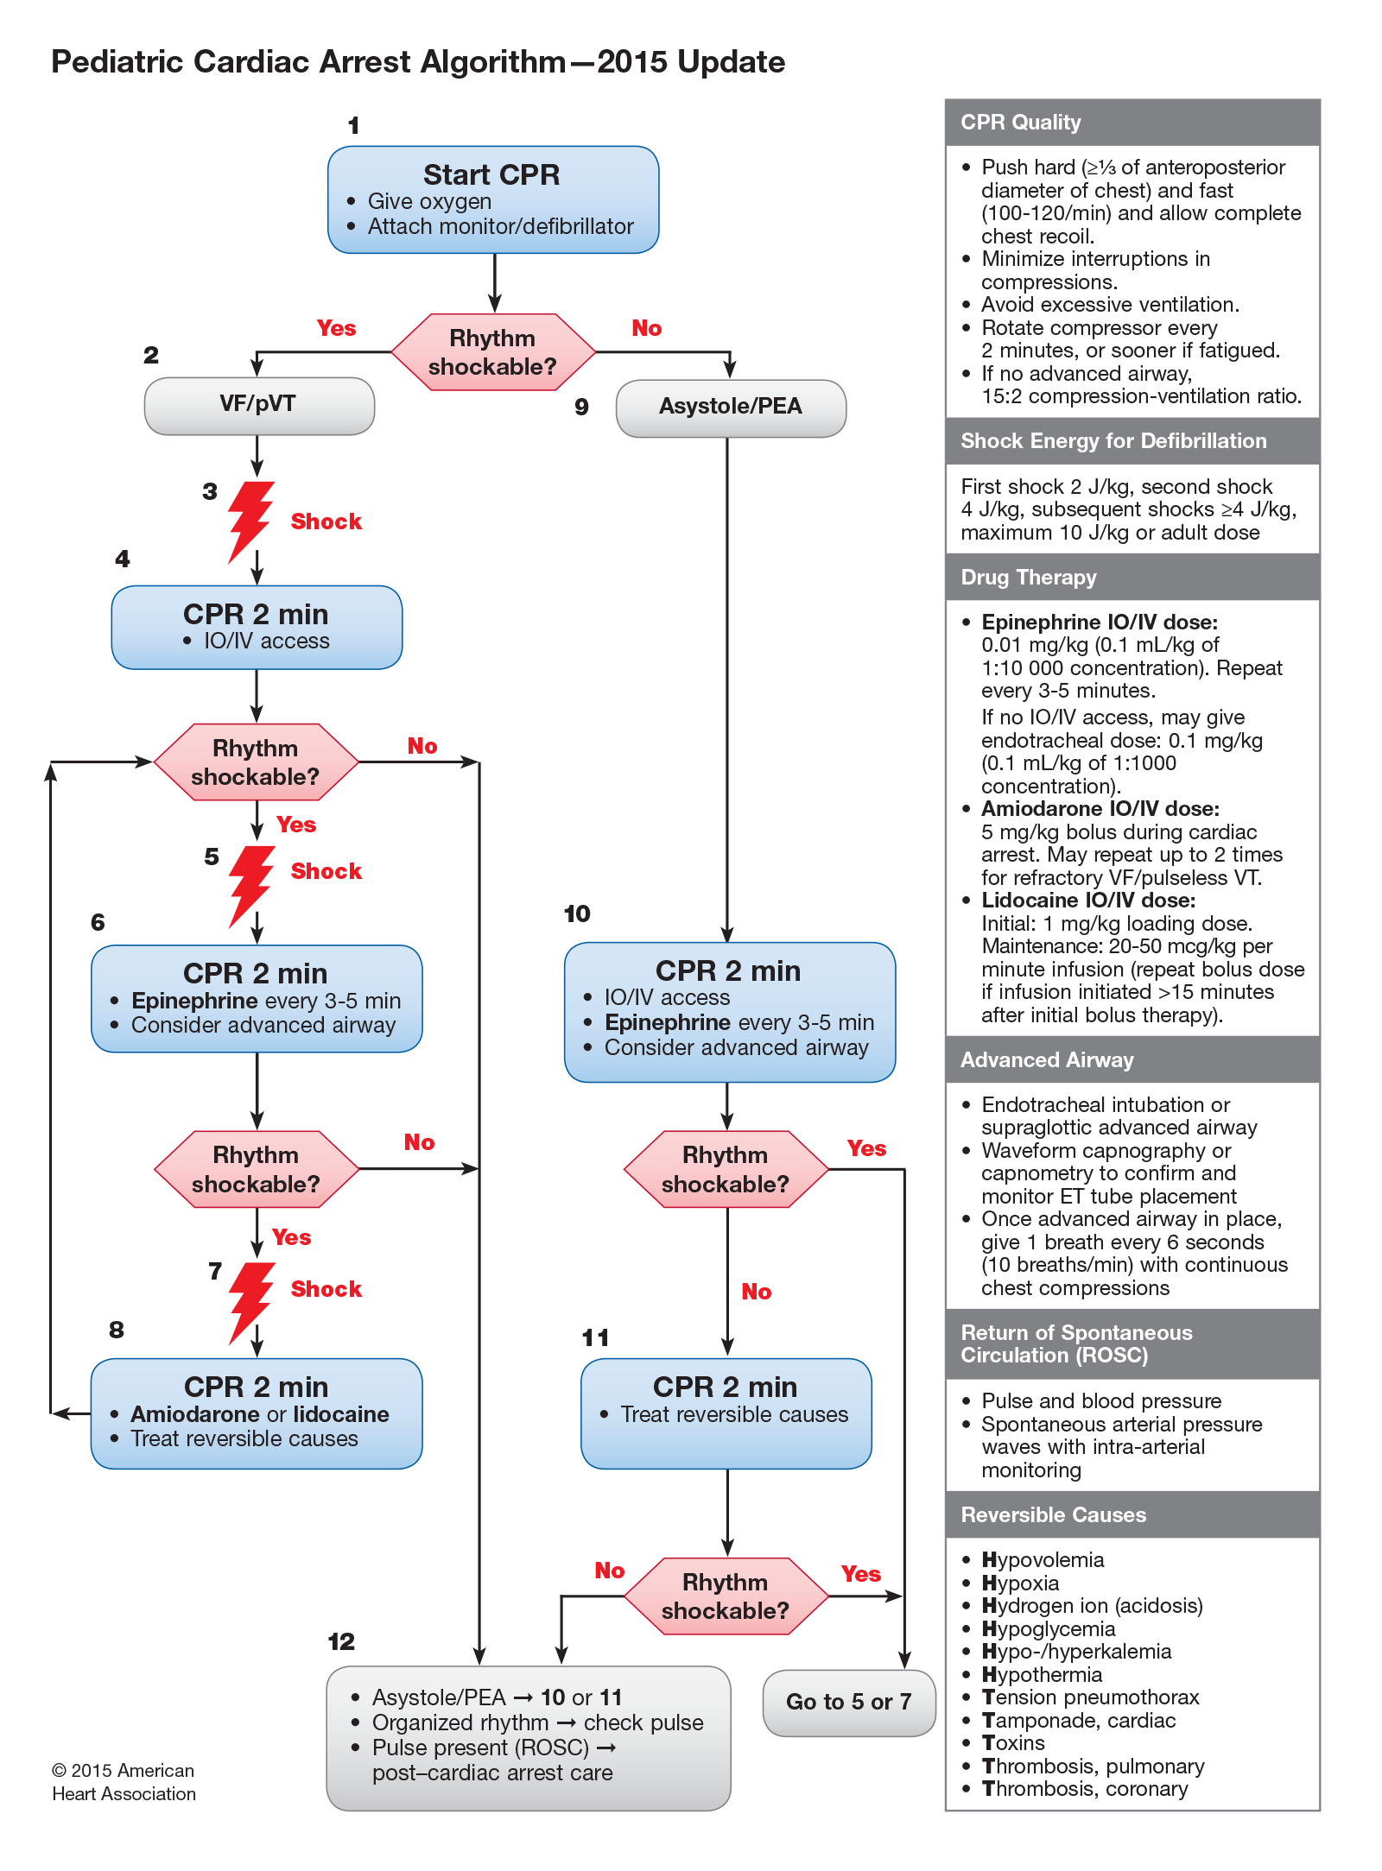

Slide 51
THANK YOU FOR VALUABLE ATTENTION AND HEARING

